Slide 1
Introduction To Software Engineering
Outline:
1.Nature of Software Project
2.Engineering Approach
3.Software Process
4.A process Step
5.Charecteristics of a good process.

Slide 2
Introduction To Software Engineering
Challenges in large project
1.Effort Intensive
2.High Cost
3.Large Development Time
4.Changing needs for user
5.High risk of failure , user acceptance ,performance ,maintainability

Slide 3



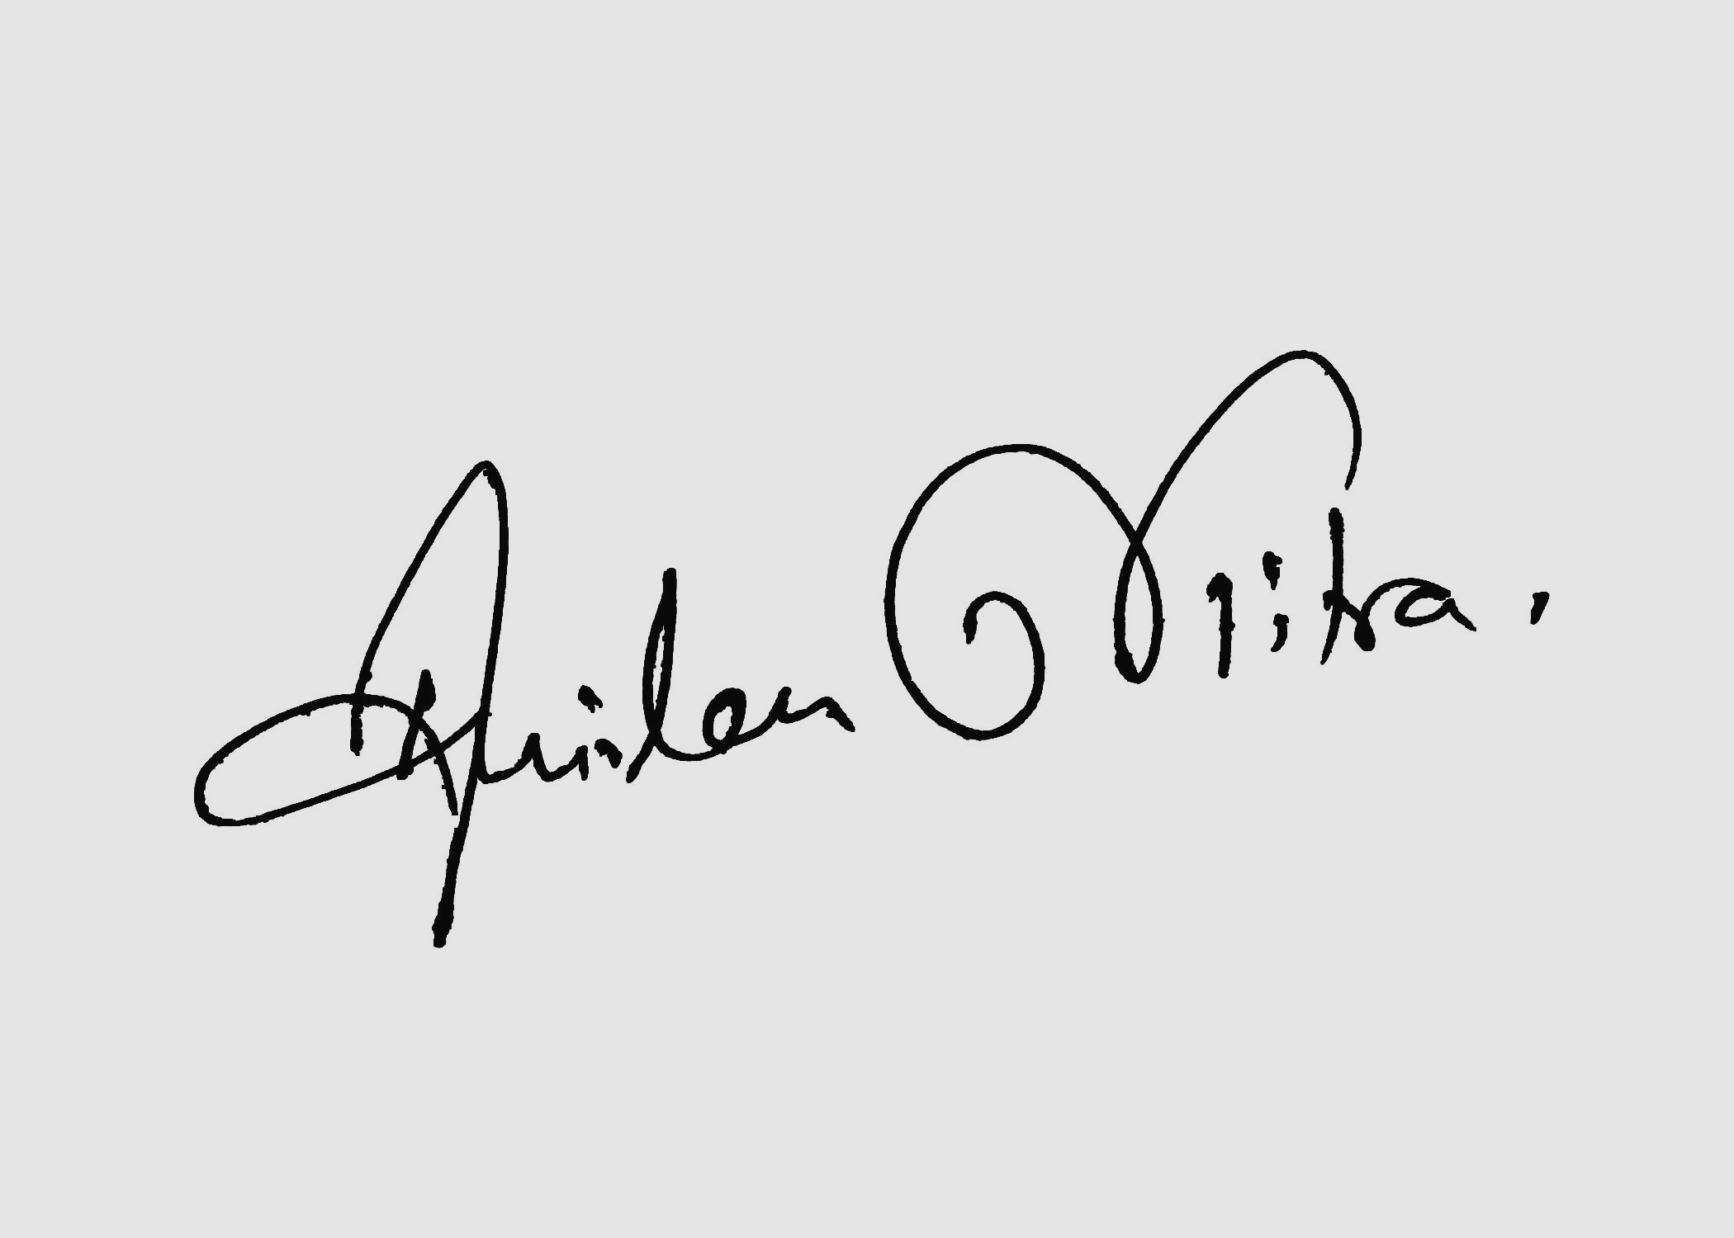
Why Software Engineering?
Late 1960 H/W prices were falling but S/W prices rising
Many Software Project failed
They did not satisfy the requirements.

Slide 4
…..
Larger SP require larger Team
Complexity of software project increased.
Larger software system are more difficult & expensive to maintain
Demand of new S/W increased faster than ability to generate new Software
All of the above are the attributes of “Software Crisis”
The term software “Software Engineering” First introduced at a conference in late 1960 to discuss the “Software Crisis”

Slide 5

Successful Software System
Software development project have not always been successful
When do we consider a software application successful?
Development Completed
It is use full
It is Usable
It is Used

Slide 6
Some inspiration quote:
“Ideas are the building blocks of ideas”-Jason
“Computer make it easy to do a lot of things, but most of the things they make it easier to do don’t need to be done”- Andy Rooney
“There is no computer that has common sense”-Marvin Minsky
“You can’t always predict ,but you can always prepare”-

Slide 7
Reasons for failure
Schedule slippage
Cost overruns
Does not solve user’s problem
Poor quality of Software
Ad-hoc software development results in such problems
No planning of development work

Slide 8
Reasons…..
Deliverables to user not identified
Poor understanding of user requirement
No control or review
Technical incompetence of developers
Poor understanding of cost & effort by both developers & user.

Slide 9


Engineering :Other Disciplines
Large projects common & successfully done
Building bridges,dams
Power Plants
Aircraft,missiles

Slide 10
“Engineering” a solution-
To design,develop(build,fabricate) an artifact that meet specifications efficiently ,cost effectively & ensure quality
Using scientific principles
Cycles: Specification Cost Effecive
Good Quality

Slide 11
“Engineering” a solution…..
Require well-define approach,repeatable,predictable
Large projects requires managing the project itself
Manage people ,money,equipment,schedule
Scale makes big Difference: a hut,2 storeyed building ,50 storeyed building

Slide 12
“Engineering” a solution-
Quality extremely important : relates to failure,efficiency,usabilty
People willing to pay for quality
E.g: buying T.V

Slide 13

Large project:
Involve different typrs of people:
Architect,civil engineer,electrical engineer.
Continuous Supervision for quality assurance:
On site supervision(check cement,steel quality…)
Many delivarables: architecture plan,model,structure diagrams,electrical cabliing,layout..

Slide 14
Large project:
Standars,regulation.conventations need to be followed.
Steps ,milestones defined & reviews are carried out:progress is visible

Slide 15
Software Project
Software is different from the other product:
Cost of production concentrated in development
Maintenance consists of making corrections && enhancing or adding functions
Progress in development is difficult to measure:
80% or 90% complete.

Slide 16
Apply Engineering approach:
Planning & control even more important in software development.
Attemp of estimate cost/effort
Plan & schedule work
Involve user in defining requirements
Identify stages in development
Define clear milestones so that progress can be measured

Slide 17
Apply Engineering approach:
Schedule reviews both for control & quality
Define deliverables
Plan extensive testing

Slide 18
What is Software:
Software is programs to provide functions and performance of desire tasks.
Collection of computer programs,procedures,rules & associative documentation & data
Computer instruction written to be executed on hardware,including OS,utility programs & aplication programs

Slide 19
What is Engineering
Engineers try to discover problems and find / develp and aply appropriate theory,methods,tools,to the solution of the problems

Slide 20
What is Software Engineering?
“SE is concerned with software system developed by teams rather than individual programmers, uses engineering principles in the development of these system and is made up of both technical & non-technical aspects.” -: (Sommerville)
“SE is a discipline that integrates method ,tools & procedure for the development of computer software”-: (Pressman)
“The systematic approach to the development , operation , maintenance,& retirement of software” :- (IEEE)

Slide 21
What issues are considerd in Software Engineering?
What is the problem to be solved
What are the features of the entity that are used to solve the problem
How will the solution be realized
What approaches will be used to uncover errors in the design and construction of the entity
How entity will be maintained

Slide 22
Software Application
System Software
Programming Languages:Basic,C,C++
Operating System: WINDOWS ,LINUX,UBUNTU
Utilities: They expands the performance of the OS by adding functions that are not part of the original OS. File conversion, data compression ,defragmentation are the examples of utility software.
Application Sofware
Spreadsheets
Database Management
Word Processing
Games & Entertainment
Internet

Slide 23
Software Errors
What are the reasons:
Specification may be wrong
The system design may be wrong
The program design design may be at fault
The program code contains error

Slide 24
Types of errors:-
Algorithmic error
Syntax error
Computation & precision error
Documentation error
Stress of overloaded error
Capacity or boundary error

Slide 25
Job of Software Developer
Dealing with user :
Concern with ease of use & response time.
Dealing with technical people:
Concerned With coding , databases , file structure etc.
Dealing with Management:
Concerned with return on their investment.
Cost-Benefit analysis.
Schedule

Slide 26
Software Process
For success in large Software development,it is important to follow an engineering approach,consisting of a well-defined process.
Process consists of activities/steps to be carried out in a particular order.
Software process deals with both technical & management issues.
Consists of different types of proces

Slide 27
Process Types…
Process for Software development:
Produces Software as end result.
Multiple such processes may exist.
A project followes a particulor process.
Process for managing the project :
Defines project plaunning & control.
Effect estimates made & schedule prepared.
Resources provided.
Feedback taken for quality assurance.
Monitoring done.
Process for managing the above processes themselves:
Improving the processes based on new techniques,tools etc.
Standardizations & certification(ISO,CMM)

Slide 28
Multiple Processes
A large development company may have multiple development processes.
For client server based conventional application(sales processing,payroll).
For enterprise-level project based on pachages & customerization
For web based e-commerce Type
For data warehousing/decision type.
Company may have many projects in each category.

Slide 29
Steps in Process
Each step has a well-defined objective
Requires people with specific skills.
Uses specific techniques ,tools ,guidelines.
Takes specific inputs & produces well defined output.
Step define when it may begin(Entry criteria) & when it ends(exit criteria)
Step must be executed as per project plan that gives duration ,effort,resource,constrains.
It must produces informations for management so that corrective action can be taken.
E.g adding more resources.
A step ends in a review(V &V)
Verification :
Check consistency of outputs with inputs(of the step)
Validation:
Check consistency with user needs.

Slide 30
Process Steps
Entry Criteria
Action to be carried out
Review V & V
Exit
Criteria
Information for Management
Project Control Information

Slide 31
Characeriistics of a Good Proecss
Should be precisely defined-:
No ambiguity about what is to be done ,when,how,etc.
It must be predictable-
Can be repeated in other projects with confidence about its outcome
Predictable with respect to effort,cost
Predictable for quality with respect to number and type of defects performance.

Slide 32
Characteristics of a Good Proecss..
Predictable process is said to be “under Statistical control” where actula values are close to expected values.
It supports testing & maintainabilty
Maintenance by third party.
Follow standars,provide necessary documentation
This charecteristic differentates between prototype & product
Facilitates early detection of and removeal of defects.
Dfect add to project cost.
Late detection & correction is costly
It should facilitate monitoring & improvement
Based on feedback
Permit use of new tools,technology
Permit measurments

Slide 33
Waterfall Model for development
System Eng
Analysis Project Planning
DEsign
Coding
Testing/Integration
Installation .Maintainance

Slide 34
Try to understand the overall problem what type of responsibllity have to be carried out by the software
Undersatnd problem domain/Data Structure
System Eng
Analysis Project Planning
DEsign
Coding
High level Design,Translate the rquirment into software Arc
Testing/Integration
Installation .Maintainance

Slide 35
Waterfall Model
FS
RA
Design
Coding & unit Testing
Integration & System Testing
Maintainance

Slide 36
Deliverables in Waterfall Model
Project plan & feasibilty Report: Cost & time
Requirement document:SRS
System Design Document
Detailed Design Document
Test plans & test Report
Source Cose : EXE form
Software manuals:User Manual,Installation manual
Review Report

Slide 37
Shortcoming Of WM
Requirements may not be clearly known, Especially for applications not having existing counterpart
Railway reservation: Manual system existed, so SRS can Be defined
On-line container management for railways
Knowledge management for central bank
Requirement change with time during project life cycle itself…

Slide 38
Shortcoming Of WM…
Requirement change with time during project life cycle itself…
User may find solution of little use
Better to develop in parts in smaller increments
This is common for packages, System software
Consider documentation heavy: so much documentation may not be required for all types of project.

Slide 39
Iterative Waterfall Model
FS
RA
Design
Coding & unit Testing
Integration & System Testing
Maintainance

Slide 40
Shortcoming of the Iterative Waterfall Model
Waterfall model cannot satsfactory handle the deffernt types of risks that a real life software project my suffer from.E.g The waterfall model assumes that requirement are completely specified before the rest of the development activity can start.
Rigid phase sequence can develop some blocking states.E.g: once a developer completes his work ,he idles waiting for the phase to get over.Since the work required to be done in a phase is distributed among several team members,some members may complete their work earlier than other member.

Slide 41
Prototyping Model
A prototype is a toy implementation of the system. A prototype usually exhibits limited functional capabilities, low reliability, and inefficient performance compared to the actual software. A prototype is usually built using several shortcuts. The shortcuts might involve using inefficient, inaccurate, or dummy functions. The shortcut implementation of a function, for example, may produce the desired results by using a table look-up instead of performing the actual computations. A prototype usually turns out to be a very crude version of the actual system.

Slide 42
Prototyping Model…. Need for a prototype in software development
There are several uses of a prototype. An important purpose is to illustrate the input data formats, messages, reports, and the interactive dialogues to the customer. This is a valuable mechanism for gaining better understanding of the customer’s needs:
• how the screens might look like
• how the user interface would behave
• how the system would produce outputs

Slide 43
A prototype of the actual product is preferred in situations such as:
Example 1: User requirements are not complete
In any application software like billing in a retail shop, accounting in a firm, etc the users of the software are not clear about the different functionalities required. Once they are provided with the prototype implementation, they can try to use it and find out the missing functionalities.

Slide 44
A prototype of the actual product is preferred in situations such as:
Example 2: Technical issues are not clear
Suppose a project involves writing a compiler and the development team has never written a compiler.
In such a case, the team can consider a simple language, try to build a compiler in order to check the issues that arise in the process and resolve them. After successfully building a small compiler (prototype), they would extend it to one that supports a complete language.

Slide 45
Disadvantages Of Prototype Model
Standardization:-
Proved the tools that totype ,particularly the high technology prototyping environments tense to be saved the tools that are available rather than by user needs
Destruction:-
Work on the prototype can take attention away from the problem to be solved
Deduction: Developers can be trapped in an endless loop of refinement
Rejection: Early detection

Slide 46
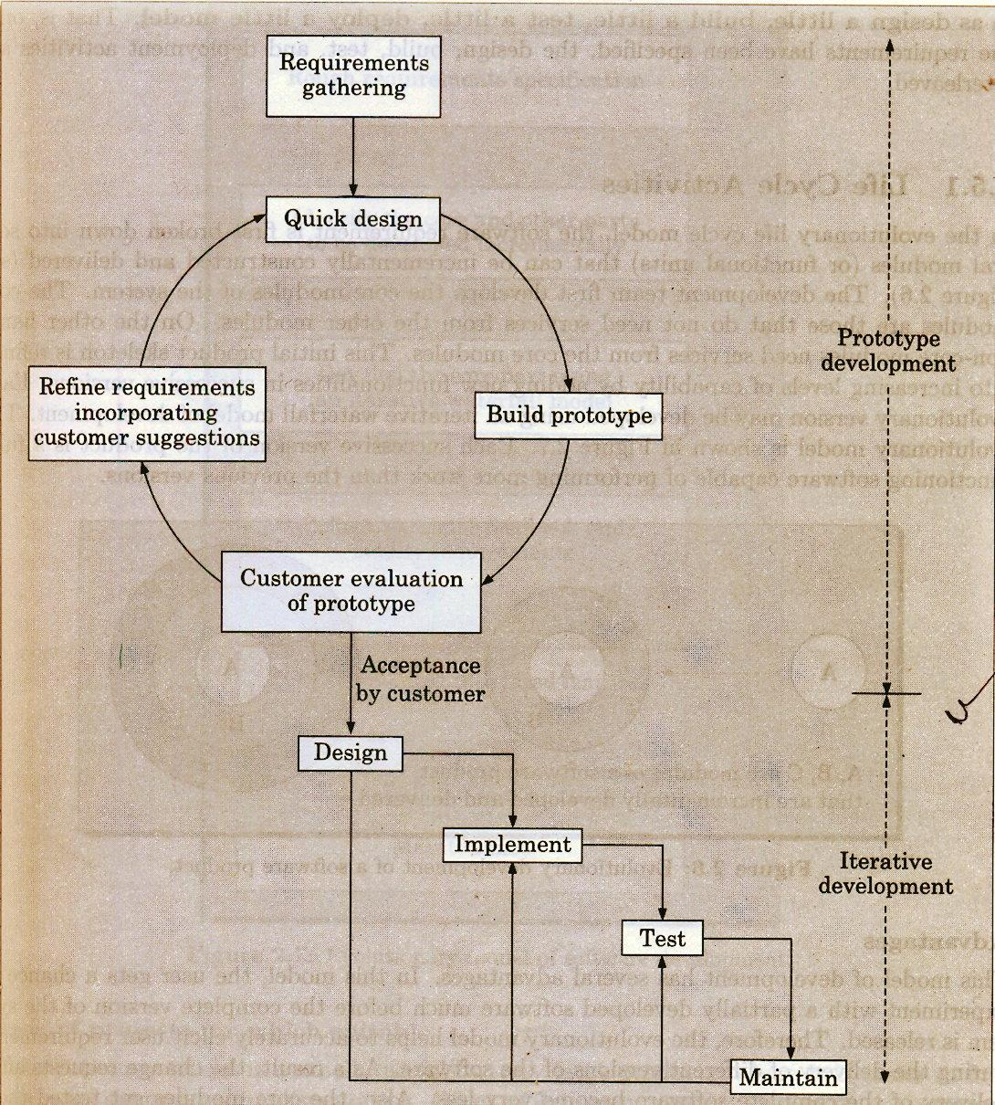

Slide 47
Evolutionary Model
It is called successive version or incremental models
The whole software is broken into different modules(functional) units.
The core module is first developed and get incremented.
The user get chance to experiment on a partially developed software
The core modules get listed to reduce the errors.

Slide 48
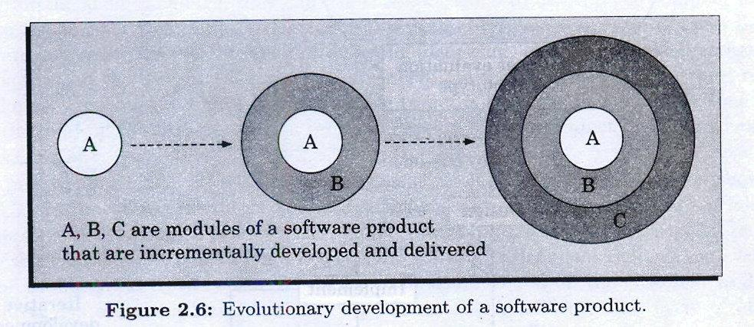
Evolutionary Model

Slide 49
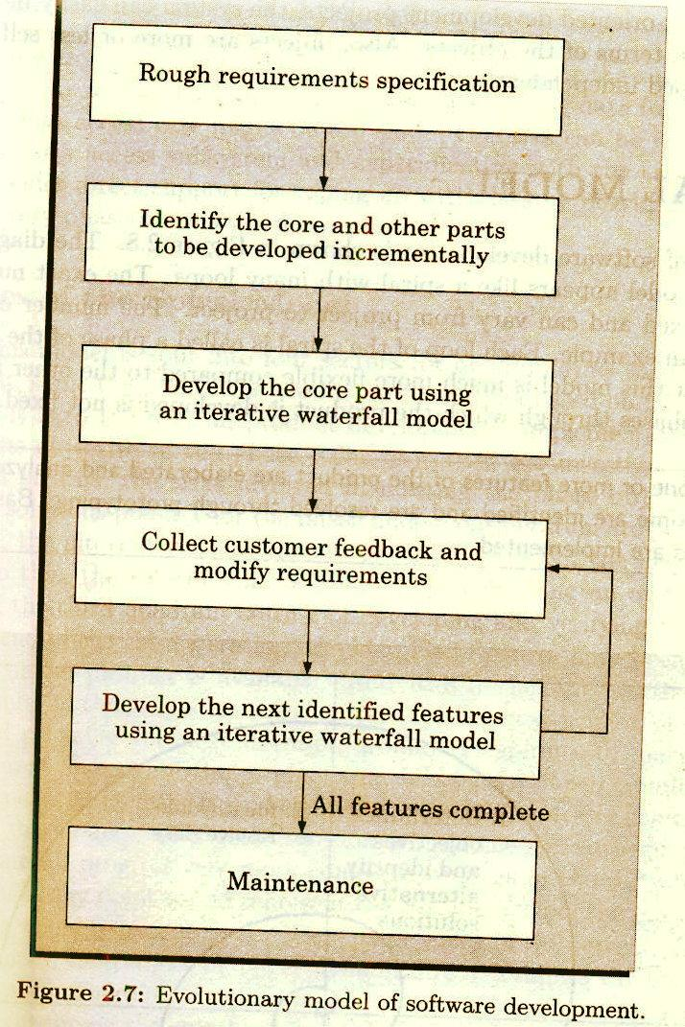

Slide 50
Evolutionary Model
This model reduce risk
Incremental process may be incorporated rapidly.
Software requirments changes ratanpidly.Then this model is effective,when the client request for new system
Lack of understanding the project means,more no. of refinement,fill the system is accepted by the client.
Initially it seems that there is no technical soloution,but refinement is required.

Slide 51
Evolutionary Model
Advantages:
Effort for prototype is not wanted.
Faster than water fall model
High level interaction from the beginning.
Discovery of new methods may be involved

Slide 52
Evolutionary Model
Disadvantages:
Difficult to plan as amount of effort is uncertain
Documentation may be neglected
Poor structure coding.

Slide 53
Spiral Model
In spiral model activities are organized in the form of spiral.The spiral has many cycle.
Exact no of loops are not fixed
Each loop of the spiral represents a phase S/W process.
“Risk”:It is essentially any adverse circumstances that might hamper the successful completion of software project:Ex: Accessing data form a remote database can be that data access rate might be too slow.The risk can be resolved by building a prototype of the data access subsystem

Slide 54
Spiral Model
“Radius” of the spiral at any represents the cost incurred in the project till them.
“Angular Dimension” represents the progress made in the current phase.
It is called Meta Model
A SINGLE-LOOP spiral actally represents the waterfall model
It uses prototyping as a risk reduction mechanism.
The iterations along the spiral model can be considered as evolutionary level through which the complete system built.

Slide 55
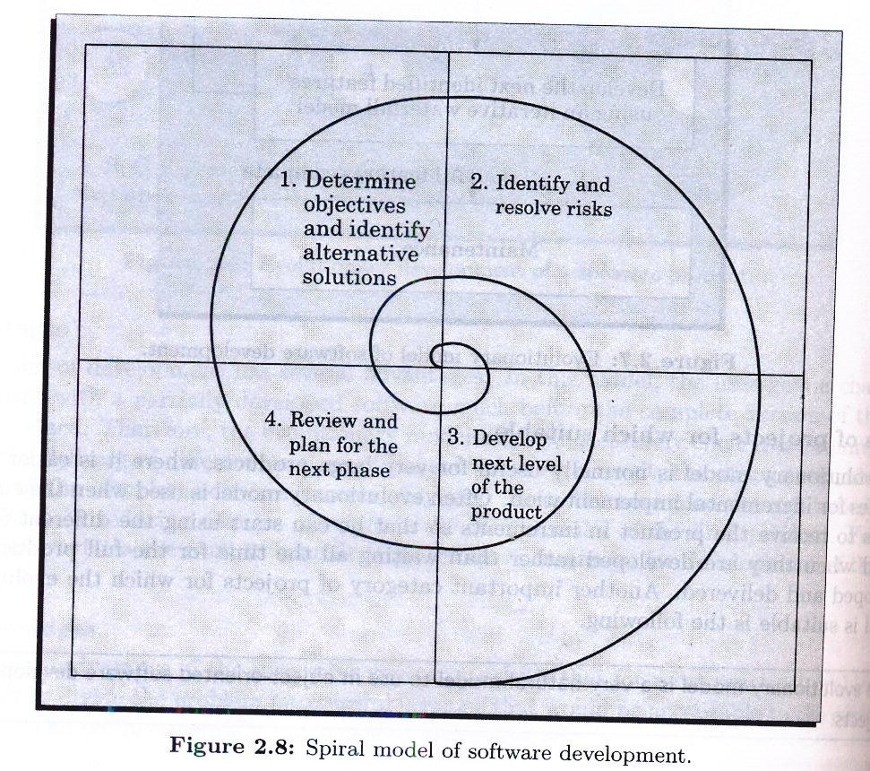
Spiral Model

Slide 56
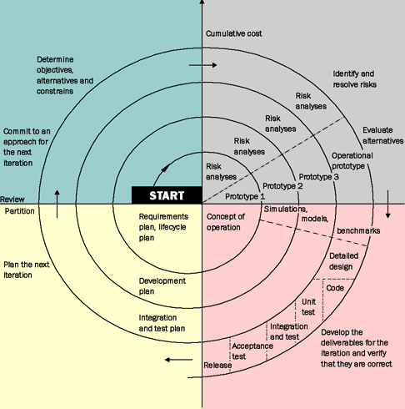

Slide 57
Spiral Model begins with…
Objective setting
Identifying alternatives
Risk assessment & reduction
Development & validation
Planning

Slide 58
Templates for a spiral round
Objective: Goal of the analysis
Constraints: Factors that limits possibilities.
Alternatives:Different ways to active objective
Risk: Analyzing the dangers associated with every alternatives.
Risk Reduction: Strategies incorporated to reduce the risk
Result:Outcome of risk reduction
Plan:How to approach to the next phase
Commitment:Management decision regarding continuation

Slide 59
Spiral Model
Advantages:
For high risk project this model may be better than any other model
Lead time means decision of top level management
First level may be cancled and second cycle begins with new task

Slide 60
Spiral Model
Disadvantages:
At some extent spiral model is theoritical and hence not possible to follow it at all the phases.The program developers don’t like to adopt this model as the theoritical approach is not allways suitable with their practical work.

Slide 61
Spiral Model as a Meta Model
The spiral model is called a meta model since it encompasses all other life cycle models. Risk handling is inherently built into this model. The spiral model is suitable for development of technically challenging software products that are prone to several kinds of risks. However, this model is much more complex than the other models – this is probably a factor deterring its use in ordinary projects.

Slide 62
Comparison of different life-cycle models
The classical waterfall model can be considered as the basic model and all other life cycle models as embellishments of this model. However, the classical waterfall model can not be used in practical development projects, since this model supports no mechanism to handle the errors committed during any of the phases.

Slide 63
Comparison of different life-cycle models…
This problem is overcome in the iterative waterfall model. The iterative waterfall model is probably the most widely used software development model evolved so far. This model is simple to understand and use. However, this model is suitable only for well-understood problems; it is not suitable for very large projects and for projects that are subject to many risks.

Slide 64
The prototyping model is suitable for projects for which either the user requirements or the underlying technical aspects are not well understood. This model is especially popular for development of the user-interface part of the projects.

Slide 65
The evolutionary approach is suitable for large problems which can be decomposed into a set of modules for incremental development and delivery. This model is also widely used for object-oriented development projects. Of course, this model can only be used if the incremental delivery of the system is acceptable to the customer.

Slide 66
The spiral model is called a meta model since it encompasses all other life cycle models. Risk handling is inherently built into this model. The spiral model is suitable for development of technically challenging software products that are prone to several kinds of risks. However, this model is much more complex than the other models – this is probably a factor deterring its use in ordinary projects.

Slide 67
Software Project Management
The main goal of SPM is to enable a group of software developer to work efficiently towards successful completion of the project.
Responsibilities of a Software Project Manager
We can broadly classify the different activities of a project manager into project planning & project monitoring & control activities.
Project Planning
Project Monitoring & Central Activity

Slide 68
PROJECT Planning - :
Project planning involves estimating several characteristics
Of the project & then planning the project activity based on the estimates mode .Project planning undertaken immediately after the feasibility study & before the requirement analysis specification phase.
Project Monitoring & Control Activity:
The project monitoring & control activities are undertaken once the development activities start.

Slide 69
Project Planning
Estimation:
Cost
Duration
Effort
The effectiveness of all other planning activities such as scheduling and staffing are based on the accuracy of these estimation.
Scheduling
Staffing
Risk Management
Miscellaneous Plans.

Slide 70
COST ESTIMATION
EFFORT ESTIMATION
SIZE ESTIMATION
DURATION ESTIMATION
PROJECT STAFFING
SCHEDULING

Slide 71
Metrics for project Size Estimation
The Project size is measure of the problem complexity in terms of the effort and time required to develop the product .
Two Metrics are:
LOC
FP

Slide 72
Line of Coding (LOC)
LOC gives a numerical value of problem size that can vary widely with individual coding style.
LOC is a measure of the coding activity alone
A good problem size measure should consider the total effort needed to specify, design ,code , test etc;
LOC measure correlate poorly with the quality & efficiency of the code . Larger code size does not necessarily imply better quality or higher efficiency

Slide 73
Line of Coding (LOC)
LOC metric penalizes use of higher-level programming language , code , reuse etc.
It measures the lexical complexity of a program & does not address the more important but subtle issues of logical or structural complexity
IT is very difficult to accurately estimate LOC in the final product from the problem specification

Slide 74
Function Point Metric
It can be used to easily estimate the size of a software directly from the specification.
SIZE dependent on the number of functions or feature.
Book name
Book location
Query Book
Input Data
Issue Book
Output Data
Return Book
LAS System

Slide 75
FP computed in three steps
Compute UFP(Unadjusted Function Point)
UFP is refined
FP is computed by further refining UFP

Slide 76
UFP
UFP=(No Of inputs)*4 + (Number of Outputs)*5 + (Number Of inquiries)*4 + (Number of files)*10 + (Number of interfaces)*10
No Of Inputs:
The data items name ,age ,sex ,address ,phone number etc are together considered as a single input.
Number of outputs:
The outputs considered refer to reports printed, screen outputs , error message produced etc.
Number of inquiries:
Number of inquiries is the number of distinct interactive queries which can be made by the users.

Slide 77
Number of files : Each logical files.
Number of interfaces: Data files on tapes ,disks , communication links with other systems , etc.

Slide 78
Refinement of Function point Metric
TYPE | SIMPLE | AVERAGE | COMPLEX
INPUT | 3 | 4 | 6
OUTPUT | 4 | 5 | 7
INQUIRY | 3 | 4 | 6
NO . FILES | 7 | 10 | 15
NO. INTERFACE | 5 | 7 | 10

Slide 79
TCF

Slide 80
TCF
A Technical complexity factor(TCF) for the project is computed and the TCF is multiplied with UFP to yield FP . Albrecht identified 14 parameters that can influence the development effort . Each of these 14 factors is assigned a value from O t0 5.The resulting numbers are summed . Now TCF is computed as (0.65+0.01*DI).As DI can vary from 0 to 70.TCF can vary from 0.65 to 1.35.Finally ,FP is given as the product of UFP and TCF . That is FP=UFP*TCF

Slide 81
Factors are :
Data communication
Distributed computing
Performance objectives
Operation configuration load
Transaction rate
Online data entry
End user efficiency
On-line update
Complex processing
Logic re-usability

Slide 82
Factors are :
Installation ease
Operational ease
Multiple sites desire to facilitate change.

Slide 83
Feature Point Metric
Major shortcoming of function point measure is that it does not take into account the algorithmic complexity of a software.
Feature point metric incorporates algorithm complexity as an extra parameter.
Feature point & function point metrics are language independent & can be easily computed from SRS.

Slide 84
Project Estimation Techniques
Estimation of various project parameters is a basic project activity, like project size , effort, project duration & cost.
Empirical estimation techniques
Heuristic Techniques
Single variable = c1 * e^{d1 (Basic Cocomo)}
Multi variable = c1 *e1^d1 +c2*e2^d2………cn*en^dn
Analytical estimation technique

Slide 85
Empirical Estimation Techniques
Based on making educated guess of the project parameters. Prior EXPERIENCE with development of similar product is helpful. Based on common sense.
Expert judgment Technique :
This is subject to human error.
It may still exhibit bias on issues where the entire group of experts may still exhibit may be biased due to reasons such as political consideration.
It may be dominated by overly assertive members

Slide 86
Empirical Estimation Techniques
Delphi Cost Estimation:
It is carried out by a team comprising of a group of experts and a coordinator.
SRS
Coordinator
Estimated Document
Expert 1
Compilation
Summary Information include any
unusual rational note
Expert 2
Re Estimated Document
Expert 3
Final Estimate

Slide 87
A Heuristic Estimation technique
COCOMO MODEL
Constructive Cost Estimation Model was proposed by Bohem,1981
Boehm's definitions of organic , semidetached & embedded systems are elaborated as follows :
Organic : We can consider a development project to be of organic type , if the project deals with developing a well-understood application program , the size of the development ream is reasonably small, and the team members are experienced in developing similar types of projects.
Semidetached: If the development team consists of a mixture of experienced and inexperienced staff.
Embedded: A development project is considered to be of embedded type , if the software being developed is strongly coupled to complex hardware , or if stringent regulations on the operational procedures exist .

Slide 88
PM is considered to be an appropriate unit for measuring effort
Number of persons working on the project
Time in months
Person-month curve

Slide 89
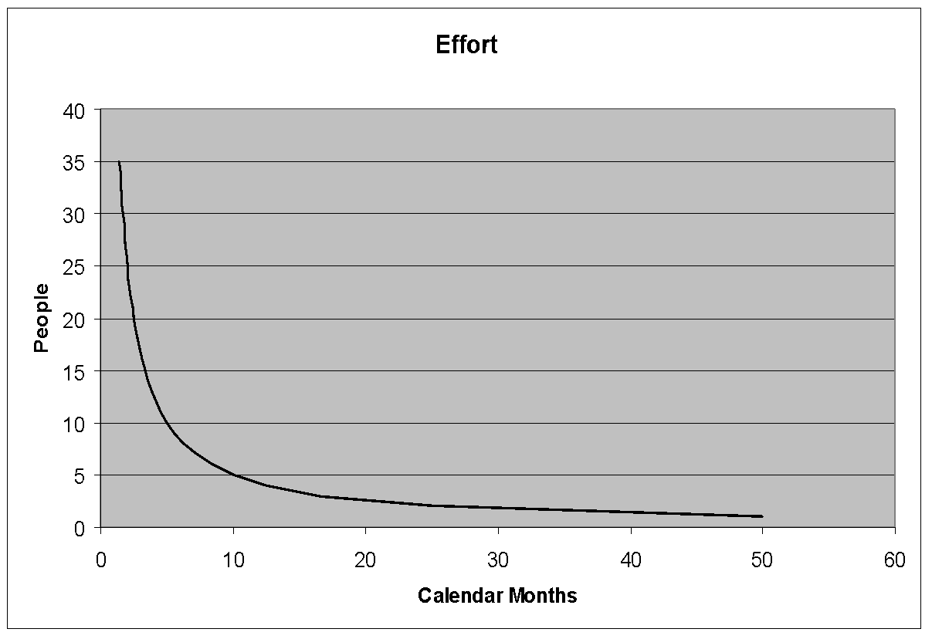
People vs Months
People | Months
50.0 | 1
25.0 | 2
16.7 | 3
12.5 | 4
10.0 | 5
8.3 | 6
7.1 | 7
6.3 | 8
5.6 | 9
5.0 | 10
4.5 | 11
4.2 | 12
3.8 | 13
3.6 | 14
3.3 | 15
3.1 | 16
2.9 | 17
2.8 | 18
2.6 | 19
2.5 | 20

Slide 90
Basic COCOMO Model
Effort=a1 * (KLOC)^{a2} PM
Tdev=b1*(Effort)^{b2} Months
KLOC =Kilo Lines of Code
a1,a2,b1,b2 are constant for each category of software products
Tdev is the estimated time to develop the software
Effort expressed in person month.

Slide 91
Effort Estimation (Basic COCOMO)
Organic : Effort = 2.4(KLOC)^{1.05} PM
Semidetached : Effort = 3.0(KLOC)^{1.12} PM
Embedded = 3.6(KLOC)^{1.20} PM
Effort Estimation (Detailed COCOMO)
Organic : Effort = 3.2(KLOC)^{1.05} PM
Semidetached : Effort = 3.0(KLOC)^{1.12} PM
Embedded = 2.8(KLOC)^{1.20} PM

Slide 92
Estimation of development time
Organic : Tdev = 2.5(Effort)^{0.38 Months}
Semidetached : Tdev = 2.5(KLOC)^{0.35 Months}
Embedded :Tdev= 2.5(KLOC)^{0.32 Months}

Slide 93
COST : TIME * RATE PER UNIT Rs
Productivity = KLOC / Effort
Average Staff Size : Effort / TDEV (person)

Slide 94
Ex :Assume that the SIZE of an organic type software product has been estimated to be 32,000 lines of source code .Assume that the average salary of software developers is RS 15,000 per month. Determine the effort required to develop the software product ,the nominal development time and cost to develop the product
From the basic COCOMO estimation formula for organic software:
Effort = 2.4 * (32)^{1.05 =} 91 PM
Nominal development Time: 2.5 *⁽91)^{0.38 = 14 months}
Cost required to develop the product = 14*15000=
Rs 210,000.

Slide 95
Intermediate COCOMO
BASIC COCOMO deals with only the program size
Others parameters should be considered to get accurate cost
COST DRIVER is introduces to refine initial cost
A set of 15 cost drivers depending on different parameters
COST driver can be classified
Product
Computer
Personal
Development Environment

Slide 96
Complete COCOMO
Previous COCOMO models considers homogeneous entity
Large Systems divided into different subsystems, Those are may be mixture of organic ,semidetached & embedded
Each subsystem requires individual cost estimation ,effort, development time manipulation.

Slide 97
COST DRIVER :
COST DRIVER | RATING
 | VERY LOW | LOW | NOMINAL | HIGH | VERY HIGH
PRODUCT ATRIBBUTES
RELY,REQUIRED RELIABILITY | 0.75 | 0.88 | 1 | 1.15 | 1.4
DATA,DATABSE SIZE |  | 0.94 | 1 | 1.08 | 1.16
CPLX,PRODUCT COMPLEXITY | 1.7 | 0.85 | 1 | 1.15 | 1.3
COMPUTER ATTRIBUTES
TIME,EXECUTION TIME |  |  | 1 | 1.11 | 1.3
STOR,MAIN STORAGE CONST |  |  | 1 | 1.06 | 1.21
VITR,VIRTUAL MACHINE VOLATILITY |  | 0.87 | 1 | 1.15 | 1.3
TURN,TURNAROUND TIME |  | 0.87 | 1 | 1.07 | 1.15
PERSONAL ATTRIBUTES
ACAP,ANALYST CAPABILITY | 1.46 | 1.19 | 1 | 0.86 | 0.71
AEXP,APPLICATION EXP | 1.29 | 1.13 | 1 | 0.91 | 0.82
PCAP,PROGRAMMER CAPA | 1.42 | 1.17 | 1 | 0.86 | 0.7
VEXP,VIRTUAL MACHINE EXP | 1.21 | 1.1 | 1 | 0.9
LEXP,PROG. LANGAGE EXP | 1.14 | 1.07 | 1 | 0.95
PROJECT ATTRIBUTES
MODP,MODERN PROG. PRACTICES | 1.24 | 1.1 | 1 | 0.91 | 0.82
TOOL,USE OF SW TOOL | 1.24 | 1.1 | 1 | 0.91 | 0.83
SCHED,DEVELOPMENT SCHEDULE | 1.23 | 1.08 | 1 | 1.04 | 1.1

Slide 98
PHASE-WISE DISTRIBUTION OF EFFORT
PHASE | SIZE
 | SMALL(2 KLOC) | INTERMEDIATE(8 KLOC) | MEDIAM(32 KLOC) | LARGE(128)
PRODUCT DESIGN | 16 | 16 | 16 | 16
DETAILED DESIGN | 26 | 25 | 24 | 23
CODE & UNIT TEST | 42 | 40 | 38 | 36
INTEGERATION & TEST | 16 | 19 | 22 | 25

Slide 99
The final effort estimated by multiplied the initial estimated by the EAF. E = EAF * Ei
For Office Automation has four major modules :
Data Entry : 0.6 KLOC/Data Update : 0.6 kloc/ Query:0.8
Report : 1 .0 kloc/Total=3.0 kloc.
Cost driver : Complexity :high(1.15)/Storage:High(1.06)/Experience:low(1.13)/Programming Capability: low(1.17)./All other factors are nominal.
Now we can consider OAS as organic system :
So Ei= 3.2*3^^{1.05} =10.14 PM ,EAF= 1.15*1.06*1.13*1.17 = 1.61
E = 1.61* 10.14 =16.3 PM

Slide 100
Now total size is 3KLOC .It is belong between small & intermediate Size.
By interpolation we can find out the phase distribution :
Design=16%,Detailed Design=25.83%,C&U Testing :41.66%,Integration=16.5%
Effort estimates
Design=16%*16.3=2.6 PM,Detailed Design=25.83% * 16.3 = 4.2 pm,C&U Testing :41.66% * 16.3 = 6.8 pm,Integration=16.5%* 16.3 = 2.7 pm.

Slide 101
Problem 1: Let us assume that the softwrae product is containing an estimated to be 62000 lines of source code.The average salary of software engineers is Rs 20000/- per month. The effort & cost of the development can be?
Problem 2: A project has 400 KLOC.Estimate the effort and development time for each of the three modes.
Problem3 : A project size of 200 KLOC is to be developed .Software development team has average on similar type of products. The project schedule is not very hight. Calculate the development time ,average staff size & productivity of the project.

Slide 102
Advantages of COCOMO
Easy to verify the working involved in it.
Cost drivers are useful in effort estimation as they help in understanding the impact of different parameters involved in the cost estimation.
Efficient and good for sensitively analysis.
Can be easily adjusted according to the organization needs & environment

Slide 103
Disadvantages of COCOMO
Difficult to accurately estimate size in the early phase of the project.
Vulnerable to misclassifications of project type
Success depends on calibration of the model according to the needs of the organization .This is done during using historical data ,which is not always available
Exclude overhead cost , travel cost & other incidental cost.

Slide 104
The value of size in KLOC and different cost drivers for a project are given :
Size=200 KLOC
Cost Driver :
Software reliability : 1.15
Use of software tools : 0.91
Product complexity : 0.85
Execution time constraint :1.00
Calculate the effort for organic COCOMO model
Effort Adjustment Factor (EAF) is EAF = 1.15 * 0.91*0.85*1.00 = 0.8895
E = 3.2 * (200)^1.05 * 0.8895 = 742 PM Ans.

Slide 105
Problem :Suppose a system for office automation to be designed . There are 4 modules in the system: data entry , data update , query & report generator . The project falls in the organic category. The effort of the different modules are in the ratio 2:2:3:5 and the total size of the project is 6 KLOC in the 1st year and 2 KLOC in the 2nd year. The cost driver are :
Complexity High :1.5
Storage High: 1.06
Experience High :1.13
Program Ability : 1.17
Obtain effort estimates for entire project for different phases in 2 year.

Slide 106
COCOMO II
As the project progress through these models can be applied at the different stages of the same project :
Application composition: This model as the name suggests, can be used to estimate cost for prototyping.
Early design : This provides cost estimation during detailed design & coding stages.
Post architecture stage: this provides coat estimation during detailed design& coding stages.

Slide 107
Halstead’s Software Science :An Analytical Technique
Find out the program length & volume of the given program :
main()
{
int a,b,c,avg;
scanf(“%d%d%d”,&a,&b,&c);
avg=(a+b+c)/3;
printf(“avg = %d”,avg);
}
Unique operators : main(),(),{},int.scanf,&, ” ,” ,”;” ,=,+,/,printf
Unique operand = a,b,c,&a,&b,&c,a+b+c,avg,3,”%d..%d”,”avg=%d”,

Slide 108
n1=12,n2=11
Estimated length = (12*log₂ 12 +11 * log₂11)
= 81
Volume = Length * log₂(23)=81 * 4.52 =366
Length = N= n1 *log₂n1 +n2 * log₂n2
Volume= N * Log₂ (n1+n2) [ where n1+n2 = program vocabulary]

Slide 109
Staffing level estimation
Once the effort required to develop a software has been determined, it is also need to determine Staffing requirement for the project.
Norden’s Work
Rayleigh Curve
E = ( K/t²d ) *t * e ^{((-t)2/2t2d)}
Effort per unit Time
Time td

Slide 110
Putnam’s Work
^{m(t)} = 2K*a*t*(exp^{-at2})
^{K} : Total effort //Total cost
^{a:} : Acceleration factor [ a=1/2t²d]
td : development time // delivery time
^{m(t)} = (K/t²d)*te^{(-t2/2t2d) //} number of persons at any time t (in years)
^{m}₀ = K/(t_{d} √e) // No of person at the peak

Slide 111
Consider a large scale project for which the manpower requirement is K=600 PY and the development time is 3 years 6 months 1. Calculate the peak manning & peak time 2.What is the manpower cost after 1 year and 2 months. 3. Calculate the difficulty & manpower build up.

Slide 112
We know td = 3 years and 6 months = 3.5 years
Now mo = K/td√e = 600/(3.5*1.648) = 104 persons
We know
y(t) =K[1-e^{-at2} ]
t = 1 year & 2 months = 1.17
a = 1/(2td² ) = 0.041
Y(1.17) = 600[1- e -0.041(1.17)2]
^{= 32.6 PY}

Slide 113
Difficulty D = K / td²
= 600 / (3.5)²
⁼ 49 persons/ year
^{Manpower} Build up =
^{D0} = K/td³
^{= 600 / (3.5)3}
^{= 14 persons/ year 2}

Slide 114
Putnam’s Observation:
Small no of engineers at the beginning of the project
For planning & specification
Project progresses so more detailed work is required & therefore more engineers are required
After implementation & unit testing the no staff size falls
The team size always follows Rayleigh-Norden curve
Constant level of manpower throughout the project is wastage of effort & time increasing factor

Slide 115
Our observation
40% of the Rayleigh curve left of td & 60% is right to td . This implies that the ratio of the effort required to develop the product to its maintenance effort is approximately 40:60 .

Slide 116
Scheduling :
To schedule the project activities
Identify all the tasks needed to compute the project.
Breakdown the large tasks in the small activities
Determine the dependency among different activities
Establish the most likely estimates for the time durations necessary to complete the activities.
Allocate resources to the activities
Plan the storing & ending dates for various activities.
Determine critical path.

Slide 117
Work breakdown structure (WBS)
It is used to decompose a given task , set recursively into small activities.
MIS
Requirements Specification
Design
Code
Test
Document
DataBase Part
GUI Part
Database Part
GUI Part

Slide 118
Activity Networks
WBS representation of a project is transformed into an activity network by representing the activities identified in WBS along with their interdependencies .An activity network shows the different activities making up a project ,their estimated durations and interdependencies .Each activity is represented by a rectangular node and the duration of the activity is shown along side each task.

Slide 119
Activity Networks
Design Database Part 45
Code Database Part 105
Integration & Test 120
Specification
15
Design GUI Part 30
Code GUI part 45
Finish o
Write user Manual 60

Slide 120
Critical Path Method(CPM)
MT : To compute the project is the maximum of all path from start to finish
ES: It is the maximum of all paths from the start to this task
LS : it is the difference between MT and the maximum of all paths from this task to the finish
EF :It is the sum of the earliest start time of the task and the duration of the task.
LF: It is obtained by subtracting maximum of all paths from this task to finish from MT (exclude its duration).
ST: Slack time can be written as LF – EF .
Critical task is one with zero slack time.
A path from the start node to finish ,containing only critical task is called critical path.

Slide 121
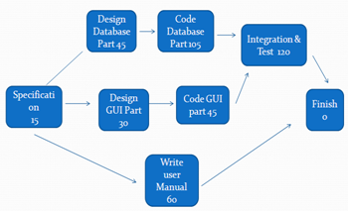
MT =285
For MIS | Duration | ES | EF | LS | LF | ST
SP | 15 | 0 | 15 | 0 | 15 | 0
DD | 45 | 15 | 60 | 15 | 60 | 0
DG | 30 | 15 | 45 | 90 | 120 | 75
CD | 105 | 60 | 165 | 60 | 165 | 0
CG | 45 | 45 | 90 | 120 | 165 | 75
IT | 120 | 165 | 285 | 165 | 285 | 0
WUM | 60 | 15 | 75 | 225 | 285 | 210

Slide 122
Gantt Chart
It is mainly used to allocate resources to activities . Like Staff ,Hardware , Software etc.
Gantt chart is a special type of bar chart where each bar represent an activity.
It is the special type of bar chart where each bar represents the activity.

Slide 123
Gantt Chart
Jan1 JAN15 MARCH15 APR1 JULY15 NOV15
SP
DESIGN DB PART
DESIGN GUI PART
CODE DB PRT
CODE GUI PRT
INTEGRATE & TEST
WRITE USER MANUAL

Slide 124
PERT CHART
Project evaluation & review technique
The boxes of PERT charts are usually annotated with the pessimistic, likely & optimistic estimates for every task.
There is not one but many critical paths, depending on the permutation of estimates for each task.
Gantt chart is helpful in planning the utilization of resources but PERT is useful for monitoring the timely progress of activity.

Slide 125
Activity Networks
Design Database Part 40,45,60
Code Database Part 95 ,105,120
Integration & Test 100,120,140
Specification
12, 15,20
Design GUI Part 24,30,38
Code GUI part 38,45,52
Finish o
Write user Manual 50,60,70

Slide 126
Organization & Team Structure
Chief Programmer Team
Project Manager
Reporting
Software Engineers

Slide 127
Democratic Team

Slide 128
Mixed control team Organization
Project Manager
Senior Engineer
Software Engineer

Slide 129
Risk Management
A risk is any anticipated unfavorable event or circumstance that can occur while a project is underway
Risk identification
Risk Assessment
Risk Containment.

Slide 130
Some possible risk are:
Experienced staff leaving the company before completion
Change in Technology
Change in requirement
Change in Government Policy
Completion from other company
Financial Problem
Underestimating cost & effort

Slide 131

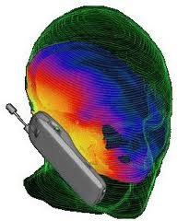

Risk
Project Risk
Business Risk
Technical Risk

Slide 132
Risk assessment
Rank the risk in terms of their damage causing potential
P= r * s
P : priority with which the risk must be handled
r : probability of the risk becoming true
s : severity of the damage due to that risk

Slide 133
Risk Containment
Avoid the risk :
Discussion with customer to change requirement/ Incentives
Transfer The Risk:
Insurance Cover
Risk Reduction:
If there is risk that some key personal might leave, new recruitment may be planned

Slide 134
Risk leverage
To choose between the different strategies of handling a risk, The Project Manager have to compute the risk leverage.
RL =
(Risk exposure before reduction - Risk exposure after reduction )
Cost Of Reduction

Slide 135
Software Configuration Management
It deals with effectively tracking and controlling the configuration of a software product during its life cycle.
A new release of software is an improved system intended to replace an old one.
Necessity Of SCM:
Inconsistency problem when the object are replicated.
Problem associated with concurrent access
Providing a stable development Environment
System accounting & maintaining status information
Handling variants

Slide 136
CM Activities
Configuration identification
It decides which part of the system should be kept track of
Configuration control :
It ensures that changes to a system happen smoothly
Prevents unauthorized changes.

Slide 137
Requirements Gathering & Analysis
Role of a system analyst
What is the problem?
Why is it important to solve the problem?
What are the possible solutions to the problem?
What exactly are the data input to the system and what exactly are the data output by the system?
What are the likely complexities that might arise while solving the problem?
If there are external software or hardware with which the developed software has to interface, then what exactly would the data interchange formats with the external system be?

Slide 138
SRS Document
The SRS document is the final outcome of the requirements analysis and specification phase.
The main activities carried out during requirements analysis and specification phase are:
Requirements gathering and analysis
Requirements specification

Slide 140
Parts of a SRS document
The important parts of SRS document are:
Functional requirements of the system
Non-functional requirements of the system, and
Goals of implementation

Slide 141
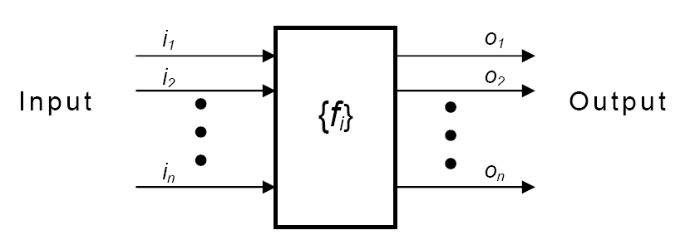
Functional Requirement

Slide 142
Nonfunctional requirements:-
Nonfunctional requirements deal with the characteristics of the system which can not be expressed as functions - such as the maintainability of the system, portability of the system, usability of the system, etc.
Nonfunctional requirements may include: # reliability issues, # accuracy of results, # human - computer interface issues, # constraints on the system implementation, etc.

Slide 143
Goals of implementation:-
The goals of implementation part documents some general suggestions regarding development. These suggestions guide trade-off among design goals. The goals of implementation section might document issues such as revisions to the system functionalities that may be required in the future, new devices to be supported in the future, reusability issues, etc. These are the items which the developers might keep in their mind during development so that the developed system may meet some aspects that are not required immediately.

Slide 144
Documenting functional requirements
Example: - Withdraw Cash from ATM
R1: withdraw cash
Description: The withdraw cash function first determines the type of account that the user has and the account number from which the user wishes to withdraw cash. It checks the balance to determine whether the requested amount is available in the account. If enough balance is available, it outputs the required cash, otherwise it generates an error message.
R1.1 select withdraw amount option
Input: “withdraw amount” option
Output: user prompted to enter the account type

Slide 145
R1.2: select account type
Input: user option
Output: prompt to enter amount
R1.3: get required amount
Input: amount to be withdrawn in integer values greater than 100 and less than 10,000 in multiples of 100.
Output: The requested cash and printed transaction statement.
Processing: the amount is debited from the user’s account if sufficient balance is available, otherwise an error message displayed.

Slide 146
Properties of a good SRS document
Concise:
The SRS document should be concise and at the same time unambiguous, consistent, and complete. Verbose and irrelevant descriptions reduce readability and also increase error possibilities.
Structured:
It should be well-structured. A well-structured document is easy to understand and modify. In practice, the SRS document undergoes several revisions to cope up with the customer requirements. Often, the customer requirements evolve over a period of time. Therefore, in order to make the modifications to the SRS document easy, it is important to make the document well-structured.

Slide 147
Black-box view:
It should only specify what the system should do and refrain from stating how to do these. This means that the SRS document should specify the external behavior of the system and not discuss the implementation issues. The SRS document should view the system to be developed as black box, and should specify the externally visible behavior of the system. For this reason, the SRS document is also called the black-box specification of a system.
Conceptual integrity:
It should show conceptual integrity so that the reader can easily understand it.

Slide 148
Response to undesired events:
It should characterize acceptable responses to undesired events. These are called system response to exceptional conditions.
Verifiable:
All requirements of the system as documented in the SRS document should be verifiable. This means that it should be possible to determine whether or not requirements have been met in an implementation.

Slide 149
Problems without a SRS document :
The important problems that an organization would face if it does not develop an SRS document are as follows:
Without developing the SRS document, the system would not be implemented according to customer needs.
Software developers would not know whether what they are developing is what exactly required by the customer.
Without SRS document, it will be very much difficult for the maintenance engineers to understand the functionality of the system.
It will be very much difficult for user document writers to write the users’ manuals properly without understanding the SRS document

Slide 150
Bad SRS means…
Over Specification :
Forward reference :
Wishful thinking :

Slide 151
Decision tree
A decision tree gives a graphic view of the processing logic involved in decision making and the corresponding actions taken. The edges of a decision tree represent conditions and the leaf nodes represent the actions to be performed depending on the outcome of testing the condition.

Slide 152
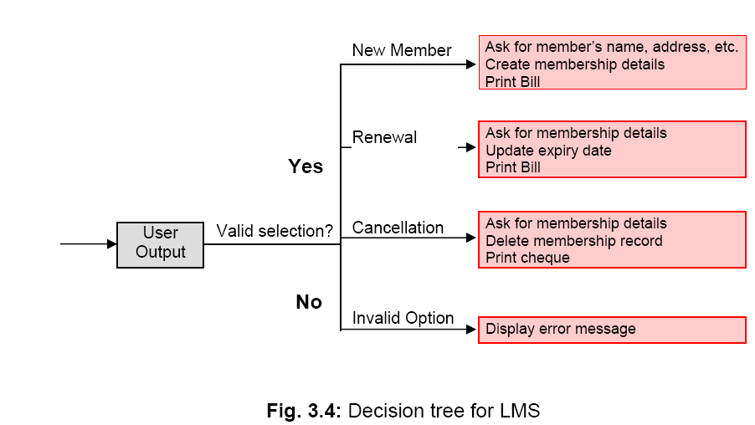

Slide 153
New member option-:
Decision: When the 'new member' option is selected, the software asks details about the member like the member's name, address, phone number etc.
Action: If proper information is entered then a membership record for the member is created and a bill is printed for the annual membership charge plus the security deposit payable.
Renewal option- :
Decision: If the 'renewal' option is chosen, the LMS asks for the member's name and his membership number to check whether he is a valid member or not.
Action: If the membership is valid then membership expiry date is updated and the annual membership bill is printed, otherwise an error message is displayed.

Slide 154
Cancel membership option-:
Decision: If the 'cancel membership' option is selected, then the software asks for member's name and his membership number.
Action: The membership is cancelled, a cheque for the balance amount due to the member is printed and finally the membership record is deleted from the database.

Slide 155
Decision table
A decision table is used to represent the complex processing logic in a tabular or a matrix form. The upper rows of the table specify the variables or conditions to be evaluated. The lower rows of the table specify the actions to be taken when the corresponding conditions are satisfied. A column in a table is called a rule. A rule implies that if a condition is true, then the corresponding action is to be executed.

Slide 156
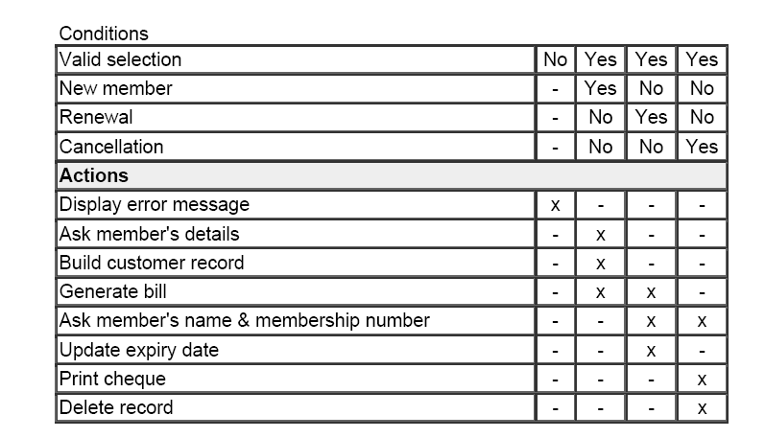
Decision table for LMS

Slide 157
Decision Table versus Decision Tree
Readability :
Explicit representation of the order of the Decision Making :
Representing very complex decision logic :

Slide 158
Organization of the SRS
Introduction :
Purpose
Overview
Environmental Characteristics
Hardware
Peripherals
People
Goal Of implementation :

Slide 159
Functional Requirements:
User class 1 :
Functional Requirement 1.1
Functional Requirement 1.2
User Class 2 :
Functional Requirement 2.1
Functional Requirement 2.2
Non-functional Requirements :
External Interface
User Interface
Software Interface
Communication Interface
Behavioral Description ::
System States
Event & Action

Slide 160
SRS Prototype Outline
[ IEEE SRS Standard ]
1. Introduction
1.1 Purpose
1.2 Scope
1.3 Definitions, Acronyms and Abbreviations
1.4 References
1.5 Overview

Slide 161
Purpose
– delineate the purpose of the particular SRS
– specify the intended audience for the SRS
Scope
– identify the SW products to be produced by name
– explain what the SW product will do, and if
necessary, what it will not do
– describe the application of the SW being specified. ie.
benefits, objectives, goals as precisely as possible
Overview
– describe what the rest of the SRS contains
– how the SRS is organized

Slide 162
2. General description
2.1 Product perspective
2.2 Product function summary
2.3 User characteristics
2.4 General constraints
2.5 Assumptions and dependencies

Slide 163
Product Perspective
State whether the product is independent and totally
self contained
If the product is component of a larger system then:
– describe the functions of each component of the
larger system and identify interfaces
– overview of the principal external interfaces of this
product
– overview of HW and peripheral equipment to be
used
Give a block diagram showing the major components
of the product, interconnections, and external interfaces.

Slide 164
Product Functions
Provide a summary of functions the SW will
perform
The functions should be organized in such a way
that they are understandable by the user
User Characteristics
Describe the general characteristics of the eventual
users of the product. (such as educational level,
experience and technical expertise )

Slide 165
General Constraints
Regulatory policies
HW limitations
Interfaces to other applications
Parallel operation
Audit functions
Control functions
Criticality of the application
Safety and security considerations

Slide 166
3. Specific Requirements
- Functional requirements
- External interface requirements
- Performance requirements
- Design constraints
- Attributes eg. security, availability,
maintainability, transferability/conversion
- Other requirements
Appendices
Index

Slide 167
Functional Requirements
Introduction
– describe purpose of the function and the
approaches and techniques employed
Inputs and Outputs
– sources of inputs and destination of outputs
– quantities, units of measure, ranges of valid
inputs and outputs
– timing

Slide 168
Processing
– validation of input data
– exact sequence of operations
– responses to abnormal situations
– any methods (eg. equations, algorithms) to be
used to transform inputs to outputs

Slide 169
External Interface Requirements
Hardware interfaces
Software interfaces
Communications interfaces
Other requirements
– database: frequency of use, accessing capabilities,
static and dynamic organization, retention
requirements for data
– operations: periods of interactive and unattended
operations, backup, recovery operations
– site adaptation requirements

Slide 170
Appendices
Not always necessary
It may include:
– sample I/O formats
– DFD, ERD documents
– results of user surveys, cost analysis studies
– supporting documents to help readers of SRS

Slide 171
Software Design
The activities carried out during the design phase transform the SRS document into the design Document
SRS DOCUMENT
Design Process
Design Document

Slide 172
Software design and its activities
Software design deals with transforming the customer requirements, as described in the SRS document, into a form (a set of documents) that is suitable for implementation in a programming language. A good software design is seldom arrived by using a single step procedure but rather through several iterations through a series of steps. Design activities can be broadly classified into two important parts:
Preliminary (or high-level) design and
Detailed design

Slide 173
Items to be Design…
Different modules required to implement the solution.
Control relationship among the identified modules
Interface among different module
Data structure of different modules
Algorithm required to implement individual module.

Slide 174
Characteristics of a good software design…
Correctness: A good design should correctly implement all the functionalities identified in the SRS document.
Understandability: A good design is easily understandable.
Efficiency: It should be efficient.
Maintainability: It should be easily enable to change.

Slide 175
Features of a design document
In order to facilitate understandability, the design should have the following features:
It should use consistent and meaningful names for various design components.
The design should be modular. The term modularity means that it should use a cleanly decomposed set of modules.
It should neatly arrange the modules in a hierarchy, e.g. in a tree-like diagram.

Slide 176
Classification of Design Phase
Through high level design, a problem is decomposed into a set of modules identified, and also the interfaces among various modules identified.
During detailed design , each module is examined carefully to design its data structures and the algorithm.

Slide 177
Modularity & Layered
A DESIGN SOLUTION IS UNDERSTANDABLE IF IT IS MODULAR & THE MODULES ARE ARRANGED IN LAYERS .
Modularity : it implies that the problem has been decomposed into a set of modules.
Decomposition of a problem into modules facilitates taking advantage of Divide & Conquer.
A design solution is considered to be highly modular , if the different modules in the solution have high cohesion and their inter-module coupling are low

Slide 178
M 1
M 1
M 2
M 3
M 4
M2
M3
M4
M5
M 5
A modular & hierarchical Design
A design solution exhibiting poor modularity & hierarchy

Slide 179
Layered Design (Neat Arrangement)
A layered design is one in which when the call relations among different modules are represented graphically, it would result in a tree like diagram with clear layering.
A module can only invoke functions of the modules in the layer immediately below it. (Visibility & Control Abstraction)
Higher layer modules can be considered to be similar to manager that invoke the lower layer modules to get certain task done.

Slide 180
Fan-out : It is a measure of the number of modules that are directly controlled by a given module .A design having modules with high fan out numbers is not a good design as such modules modules would lack cohesion.
Fan in: It indicates the number of directly invoking a given module .High fan in represents code reuse.

Slide 181
M 1
Layer 1
Layer 2
M 2
M 3
M 4
M 5
Layer 3

Slide 182
INTRODUCTION
A module consists of:
Several functions
Associated data structures.
D1 ..
D2 ..
Data
D3 ..
F1 ..
Functions
F2 ..
F3 ..
F4 ..
F5 ..

Slide 183
INTRODUCTION
Design activities are usually classified into two stages:
High-level design.
Detailed design.

Slide 184
HIGH-LEVEL DESIGN
Identify:
Modules
Control relationships among modules
Interfaces among modules.
d1
d2
d3
d1
d4

Slide 185
HIGH-LEVEL DESIGN
Several notations are available to represent high-level design:
Usually a tree-like diagram called structure chart is used.

Slide 186
DETAILED DESIGN
For each module, design:
Data structure
Algorithms

Slide 187
GOOD AND BAD DESIGNS
There is no unique way to design a system.
Even using the same design methodology:
Different designers can arrive at different design solutions.
We need to distinguish between good and bad designs.

Slide 188
GOOD SOFTWARE DESIGN?
Should implement all functionalities of the system correctly.
Should be easily understandable.
Should be efficient.
Should be easily maintainable.
Should use consistent and meaningful names:
for various design components.

Slide 189
ABSTRACTION & DECOMPOSITION IN DESIGN?
Two principal ways:
Modular Design
Layered Design

Slide 190
MODULARITY
Modularity is a fundamental attributes of any good design.
Decomposition of a problem clearly into modules:
Modules are almost independent of each other
Divide and conquer principle.

Slide 191
MODULARITY
If modules are independent:
Modules can be understood separately,
Reduces the complexity greatly.

Slide 192
LAYERED DESIGN
YES
NO

Slide 193
LAYERED DESIGN
Neat arrangement of modules in a hierarchy means:
Control abstraction among modules.

Slide 194
CHARACTERISTICS OF MODULE STRUCTURE
Depth:
Number of levels of control
Width:
Overall span of control.
Fan-out:
A measure of the number of modules directly controlled by given module.

Slide 195
CHARACTERISTICS OF MODULE STRUCTURE
Fan-in:
Indicates how many modules directly invoke a given module.

Slide 196
MODULE STRUCTURE
Fan out=2
Fan in=0
Fan out=1
Fan in=1
Fan in=2

Slide 197
LAYERED DESIGN
A design having modules:
With high fan-out numbers is not a good design:
A module having high fan-out lacks cohesion.

Slide 198
GOODNESS OF DESIGN
A module that invokes a large number of other modules:
Likely to implement several different functions:
Not to perform a single cohesive function.

Slide 199
CONTROL RELATIONSHIPS
A module that controls another module:
said to be super-ordinate to it.
Conversely, a module controlled by another module:
said to be subordinate to it.

Slide 200
VISIBILITY AND LAYERING
Module B is said to be visible by another module A,
If A directly calls B.
The layering principle requires
Modules at a layer can call only the modules immediately below it.

Slide 201
BAD DESIGN

Slide 202
ABSTRACTION
A module is unaware of the higher level modules.
The modules at the higher layers should not be visible to the modules at the lower layers.

Slide 203
ABSTRACTION
The principle of abstraction requires:
Lower-level modules do not invoke functions of higher level modules.
Also known as layered design.

Slide 204
MODULARITY
In technical terms, modules should display:
High cohesion
Low coupling.
What are
cohesion and coupling???

Slide 205
COHESION AND COUPLING
Cohesion is a measure of:
functional strength of a module.
A cohesive module performs a single task or function.
Coupling between two modules:
A measure of the degree of the interdependence or interaction between the two modules.

Slide 206
COHESION AND COUPLING
A module having high cohesion and low coupling:
functionally independent of other modules:
A functionally independent module has minimal interaction with other modules.

Slide 207
ADVANTAGES OF FUNCTIONAL INDEPENDENCE
Better understandability,
Complexity of design is reduced,
Different modules easily understood in isolation.

Slide 208
ADVANTAGES OF FUNCTIONAL INDEPENDENCE
Functional independence reduces error propagation.
Degree of interaction between modules is low.
An error existing in one module does not directly affect other modules.

Slide 209
ADVANTAGES OF FUNCTIONAL INDEPENDENCE
A functionally independent module:
Can be easily taken out and reused in a different program.
Each module does some well-defined and precise function.

Slide 210
Cohesion
The primary characteristics of neat module decomposition are high cohesion and low coupling.
Cohesion is a measure of functional strength of a module.
A module having high cohesion and low coupling is said to be functionally independent of other modules.
By the term functional independence, we mean that a cohesive module performs a single task or function. A functionally independent module has minimal interaction with other modules.

Slide 211
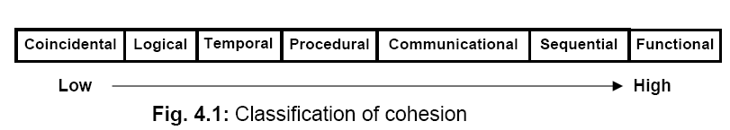
Classification of cohesion

Slide 212
Coincidental cohesion:
The module contains a random collection of functions. It is likely that the functions have been put in the module out of pure coincidence without any thought or design.
In (TPS), the get-input, print-error, and summarize-members functions are grouped into one module. The grouping does not have any relevance to the structure of the problem

Slide 213
Logical cohesion:
A module is said to be logically cohesive, if all elements of the module perform similar operations, e.g. error handling, data input, data output, etc. An example of logical cohesion is the case where a set of print functions generating different output reports are arranged into a single module.

Slide 214
Temporal cohesion:
When a module contains functions that are related by the fact that all the functions must be executed in the same time span, the module is said to exhibit temporal cohesion. The set of functions responsible for initialization, start-up, shutdown of some process, etc. exhibit temporal cohesion.

Slide 215
Procedural cohesion:
A module is said to possess procedural cohesion, if the set of functions of the module are all part of a procedure (algorithm) in which certain sequence of steps have to be carried out for achieving an objective, e.g. the algorithm for decoding a message.

Slide 216
Communicational cohesion:
A module is said to have communicational cohesion, if all functions of the module refer to or update the same data structure, e.g. the set of functions defined on an array or a stack.

Slide 217
Sequential cohesion:
A module is said to possess sequential cohesion, if the elements of a module form the parts of sequence, where the output from one element of the sequence is input to the next. For example, in a TPS, the get-input, validate-input, sort-input functions are grouped into one module.

Slide 218
Functional cohesion:
Functional cohesion is said to exist, if different elements of a module cooperate to achieve a single function. For example, a module containing all the functions required to manage employees’ pay-roll exhibits functional cohesion. Suppose a module exhibits functional cohesion and we are asked to describe what the module does, then we would be able to describe it using a single sentence.

Slide 219
Coupling
Coupling between two modules is a measure of the degree of interdependence or interaction between the two modules. A module having high cohesion and low coupling is said to be functionally independent of other modules. If two modules interchange large amounts of data, then they are highly interdependent. The degree of coupling between two modules depends on their interface complexity. The interface complexity is basically determined by the number of types of parameters that are interchanged while invoking the functions of the module.

Slide 220
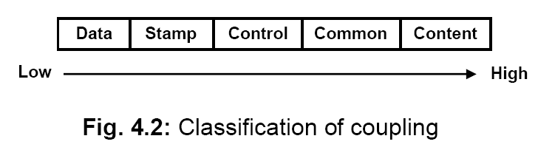
Classification of Coupling

Slide 221
Data coupling:
Two modules are data coupled, if they communicate through a parameter. An example is an elementary data item passed as a parameter between two modules, e.g. an integer, a float, a character, etc. This data item should be problem related and not used for the control purpose.

Slide 222
Stamp coupling:
Two modules are stamp coupled, if they communicate using a composite data item such as a record in PASCAL or a structure in C.

Slide 223
Control coupling:
Control coupling exists between two modules, if data from one module is used to direct the order of instructions execution in another. An example of control coupling is a flag set in one module and tested in another module.

Slide 224
Common coupling:
Two modules are common coupled, if they share data through some global data items.

Slide 225
Content coupling:
Content coupling exists between two modules, if they share code, e.g. a branch from one module into another module

Slide 226
Functional independence
A module having high cohesion and low coupling is said to be functionally independent of other modules. By the term functional independence, we mean that a cohesive module performs a single task or function. A functionally independent module has minimal interaction with other modules.

Slide 227
Need for functional independence
Functional independence is a key to any good design due to the following reasons:
Error isolation: Functional independence reduces error propagation. The reason behind this is that if a module is functionally independent, its degree of interaction with the other modules is less. Therefore, any error existing in a module would not directly effect the other modules.

Slide 228
Need for functional independence
Scope of reuse: Reuse of a module becomes possible. Because each module does some well-defined and precise function, and the interaction of the module with the other modules is simple and minimal. Therefore, a cohesive module can be easily taken out and reused in a different program.

Slide 229
Need for functional independence
Understandability: Complexity of the design is reduced, because different modules can be understood in isolation as modules are more or less independent of each other.

Slide 230
Function-oriented design
The following are the salient features of a typical function-oriented design approach:
A system is viewed as something that performs a set of functions. Starting at this high-level view of the system, each function is successively refined into more detailed functions. For example, consider a function create-new-library-member which essentially creates the record for a new member, assigns a unique membership number to him, and prints a bill towards his membership charge. This function may consist of the following sub-functions:
assign-membership-number
create-member-record
print-bill

Slide 231
2. The system state is centralized and shared among different functions, e.g. data such as member-records is available for reference and updating to several functions such as:
create-new-member
delete-member
update-member-record

Slide 232
Object-oriented design
In the object-oriented design approach, the system is viewed as collection of objects (i.e. entities). The state is decentralized among the objects and each object manages its own state information. For example, in a Library Automation Software, each library member may be a separate object with its own data and functions to operate on these data. In fact, the functions defined for one object cannot refer or change data of other objects. Objects have their own internal data which define their state. Similar objects constitute a class. In other words, each object is a member of some class. Classes may inherit features from super class. Conceptually, objects communicate by message passing.

Slide 233
Function-oriented vs. object-oriented design approach
Unlike function-oriented design methods, in OOD, the basic abstraction are not real-world functions such as sort, display, track, etc, but real-world entities such as employee, picture, machine, radar system, etc.
Function-oriented techniques such as SA/SD group functions together if, as a group, they constitute a higher-level function. On the other hand, object-oriented techniques group functions together on the basis of the data they operate on.
In OOD, state information is not represented in a centralized shared memory but is distributed among the objects of the system.

Slide 234
Functional Oriented SD
Structured Analysis[SA] :
Structured analysis is used to carry out the top-down decomposition of a set of high-level functions depicted in the problem description and to represent them graphically. During structured analysis, functional decomposition of the system is achieved. That is, each function that the system performs is analyzed and hierarchically decomposed into more detailed functions

Slide 235
Structured analysis technique is based on the following essential underlying principles:
Top-down decomposition approach.
Divide and conquer principle. Each function is decomposed independently.
Graphical representation of the analysis results using Data Flow Diagrams (DFDs).

Slide 236
SRS
DFD
STRUCTURE CHART
SA
SD

Slide 237
DFD
The DFD (also known as a bubble chart) is a hierarchical graphical model of a system that shows the different processing activities or functions that the system performs and the data interchange among these functions.

Slide 238
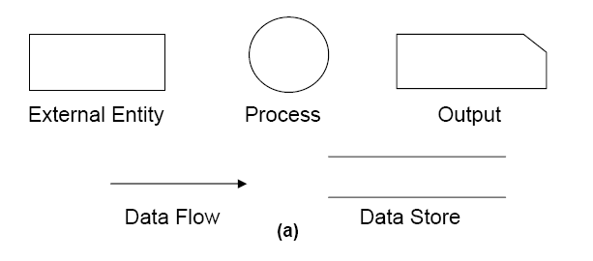
Symbols used in DFD

Slide 239
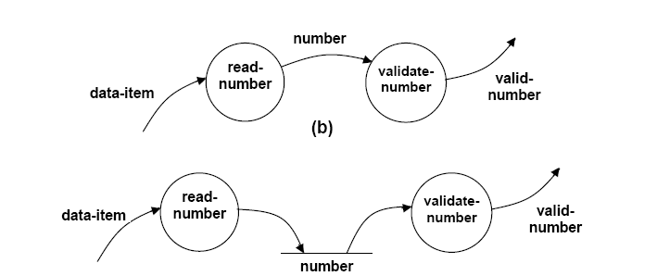
Synchronous & Asynchronous DFD
(a)
(a) Asynchronous Chart (b) Synchronous Chart

Slide 240
Context diagram /Level 0 DFD
The context diagram is the most abstract data flow representation of a system. It represents the entire system as a single bubble.
The context diagram is also called as the level O DFD.

Slide 241
RMS Calculating Software.
A software system called RMS calculating software would read three integral numbers from the user in the range of -1000 and +1000 and then determine the root mean square (rms) of the three input numbers and display it.

Slide 242
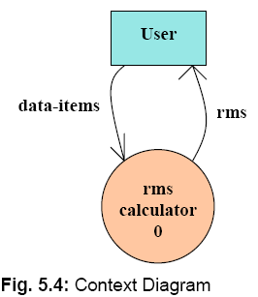
Level 0 DFD/ Context Diagram

Slide 243
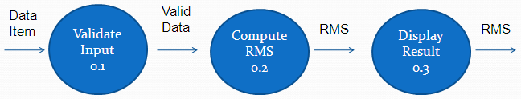
Level 1 DFD
To develop the level 1 DFD, examine the high-level functional requirements. If there are between 3 to 7 high-level functional requirements, then these can be directly represented as bubbles in the level 1 DFD.

Slide 244
Level 2 DFD
Square
0.2.1
a
asq
Mean
0.2.4
msq
Root
0.2.5
b
Square
0.2.2
bsq
rms
csq
c
Square
0.2.3

Slide 245
RMS Calculating Software Level 1
numbers
Read-numbers 0.1
Validate-numbers 0.2
Valid -numbers
Data-items
error
Display 0.4
Compute-rms 0.3
result
RMS

Slide 246
RMS Calculating Software Level 2
Squared-sum
Calculate-squared-sum 0.3.1
Calculate-mean 0.3.2
Valid -numbers
Mean-square
Calculate-root 0.3.3
RMS

Slide 247
RMS Calculating Software Level 3
b
a
c
Square 0.3.1.1
Square 0.3.1.2
Square 0.3.1.3
bsq
asq
csq
Sum 0.3.1.4
Squared-sum

Slide 248
Balancing DFDs
The Data that flow into or out of a bubble must match the data flow at the nest level of DFD. This is known as Balancing a DFD
c
b
c
c1
d1
a
d
e
Level 1
d
e1
e
Level 2

Slide 249
Data Dictionary
Every DFD model of a system must be accompanied by data dictionary. A data dictionary lists all data items appearing in the DFD model of the system.

Slide 250
Why Data Dictionary
A data dictionary provides a standard terminology for all relevant data for use by all engineers working in the same project.
It provides the analyses with means to determine the definition of different in terms of their component element.

Slide 251
DD for RMS Software
data_ items : {integer}3
rms : float
valid_data : data_items
a= integer
b= integer
c = integer
asq=integer
bsq= integer
csq= integer
msq= integer

Slide 252
Importance of Data Dictionary
Provides all engineers in a project with standard terminology for all data:
A consistent vocabulary for data is very important
Different engineers tend to use different terms to refer to the same data,
Causes unnecessary confusion.

Slide 253
Importance of Data Dictionary
Data dictionary provides the definition of different data:
In terms of their component elements.
For large systems,
The data dictionary grows rapidly in size and complexity.
Typical projects can have thousands of data dictionary entries.
It is extremely difficult to maintain such a dictionary manually.

Slide 254
Data Definition
Composite data are defined in terms of primitive data items using following operators:
+: denotes composition of data items, e.g
a+b represents data a and b.
[,,,]: represents selection,
i.e. any one of the data items listed inside the square bracket can occur.
For example, [a,b] represents either a occurs or b occurs.

Slide 255
Data Definition
( ): contents inside the bracket represent optional data
which may or may not appear.
a+(b) represents either a or a+b occurs.
{}: represents iterative data definition,
e.g. {name}5 represents five name data.

Slide 256
Data Definition
{name}* represents
zero or more instances of name data.
= represents equivalence,
e.g. a=b+c means that a represents b and c.
* *: Anything appearing within * * is considered as comment.

Slide 257
For DFD Refer Example
Design the different level of DFD For SuperMarket Prize Scheme. Also design the Data Dictionary For the DFD model.
Design L0 and L1 DFD for Tic-Tac-Toe Game. Also design the Data Dictionary.
Design L0 L1 and L2 DFD for Personal Library System. Also design the Data Dictionary.

Slide 258
Advantage of DFD
Simple graphical notation to represent the whole system with primitive symbols.
It is very simple formalism , simple to understand & rescue
It supports modular programming approach starting with a set of high level functions that a system performs, a DFD model hierarchically represent various sub functions.
Different level of abstraction are possible.

Slide 259
Shortcomings of a DFD model
Scalability: DFDs for large applications are difficult to handle.
Lack of ordering: A DFD model does not specify the order in which the different bubbles are executed.
No specific rule for decomposition: The level of decomposition is highly subjective and depends on the choice of the analyst.
For the same problem, several DFD representations are possible.

Slide 260
Supermarket Prize Distribution
SuperMarket Software
0
winner_-list
Sales-Clerk
Sales Details
Gen-winner Command
CN
Manager
Customer-Details
Customer
Context Diagram

Slide 261
Customer-details
CN
Sales-details
Register-Customer
0.1
Register-Sales
0.3
Sales-info
Customer_data
Genrate-winner-list
0.2
Generate-winner-command
Winner-list
Level 1 Diagram

Slide 262
surprise-gift-winner-list
Sales-details
Generate-winner-command
Register-Customer
0.2.3
Gen_surprise-gift-winner
0.2.1
Sales-info
Total-sales
Reset
0.2.4
Register-Customer
0.2.2
gold-coin-winner-list
Level 2 Diagram

Slide 263
DD for Supermarket Prize Software
address:name+house#+street#+city+pin
Sales-details:{item+amount}* + CN
CN:integer
Customer-data:{address+CN}*
Sales-info:{sales-details}*
Winner-list:surpize-gift-winner-list+gold-coin-winner-list
Surprise-gift-winner-list:{address+CN}*
Gold-coint-winner-list:{address+CN}*
Gen-winner-command:command
Total-sales:{CN+integer}*

Slide 264
Structured Design
The aim of structured design
Transform the results of structured analysis (i.e., a DFD representation) into a structure chart.
A structure chart represents the software architecture:
Various modules making up the system,
Module dependency (i.e. which module calls which other modules),
Parameters passed among different modules.

Slide 265
Structure Chart
Structure chart representation
Easily implementable using programming languages.
Main focus of a structure chart:
Define the module structure of a software.
Interaction among different modules.

Slide 266
Basic Building Blocks of Structure Chart
Rectangular box:
A rectangular box represents a module.
A name is assigned to the module it represents.
Process-order

Slide 267
Basic Building Blocks of Structure Chart
An arrow between two modules implies:
During execution control is passed from one module to the other in the direction of the arrow.
root
Process-order
Handle-indent
Handle-query

Slide 268
Basic Building Blocks of Structure Chart
Data flow arrows represent:
Data passing from one module to another in the direction of the arrow.
root
order
Process-order

Slide 269
Basic Building Blocks of Structure Chart
Library modules represent frequently called modules:
A rectangle with double side edges.
Simplifies drawing when a module is called by several modules.
Quick-sort

Slide 270
Basic Building Blocks of Structure Chart
The diamond symbol represents selection:
One module of several modules connected to the diamond symbol is invoked depending on some condition.
root
Process-order
Handle-indent
Handle-query

Slide 271
Basic Building Blocks of Structure Chart
A loop around control flow arrows denotes that the concerned modules are invoked repeatedly.
root
Process-order
Handle-indent
Handle-query

Slide 272
Structure Chart
There is only one module at the top:
root module.
There is at most one control relationship between any two modules:
if module A invokes module B,
Module B cannot invoke module A.
The main reason behind this restriction:
consider modules in a structure chart to be arranged in layers or levels.

Slide 273
Structure Chart
The principle of abstraction:
does not allow lower-level modules to invoke higher-level modules:
But, two higher-level modules can invoke the same lower-level module.

Slide 274
Example
main
rms
Valid-data
Valid-data
rms
Compute-solution
Display-solution
Get-good-data
Data-items
Data-items
Valid-data
Get-data
Validate-data

Slide 275
Bad Design

Slide 276
Shortcomings of Structure Chart
By looking at a structure chart:
we can not say whether a module calls another module just once or many times.
Also, by looking at a structure chart:
we can not tell the order in which the different modules are invoked.

Slide 277
Flow Chart
We are all familiar with the flow chart representations:
Flow chart is a convenient technique to represent the flow of control in a system.
A=B
if(c == 100)
P=20
else p= 80
while(p>20)
print(student mark)
A=B
yes
no
P=20
P=80
dummy
yes
no
Print

Slide 278
Flow Chart vs. Structure Chart
A structure chart differs from a flow chart in three principal ways:
It is difficult to identify modules of a software from its flow chart representation.
Data interchange among the modules is not represented in a flow chart.
Sequential ordering of tasks inherent in a flow chart is suppressed in a structure chart.

Slide 279
Coding
The objective of the coding phase is to transform the design of a system into code in a high-level language , and then to unit test this code
The purpose of requiring all engineers of an organization to adhere to a standard style of coding is the following:
• A coding standard gives a uniform appearance to the codes written by different engineers.
• It enhances code understanding.
• It encourages good programming practices.

Slide 280
Coding standards and guidelines
Rules for limiting the use of global: These rules list what types of data can be declared global and what cannot.
Contents of the headers preceding codes for different modules:
The following are some standard header data:
• Name of the module.
• Date on which the module was created.
• Author’s name.
• Modification history.
• Synopsis of the module.
• Different functions supported, along with their input/output parameters.
• Global variables accessed/modified by the module.

Slide 281
Naming conventions for global variables, local variables, and constant identifiers: A possible naming convention can be that global variable names always start with a capital letter, local variable names are made of small letters, and constant names are always capital letters.
Error return conventions and exception handling mechanisms: The way error conditions are reported by different functions in a program are handled should be standard within an organization. For example, different functions while encountering an error condition should either return a 0 or 1 consistently.
Do not use a coding style that is too clever or too difficult to understand: Code should be easy to understand.

Slide 282
Avoid obscure side effects: Obscure side effects make it difficult to understand a piece of code. For example, if a global variable is changed obscurely in a called module
Do not use an identifier for multiple purposes
The code should be well-documented: As a rule of thumb, there must be at least one comment line on the average for every three-source line.
The length of any function should not exceed 10 source lines
Do not use goto statements: Use of goto statements makes a program unstructured and makes it very difficult to understand. Do not use goto statements: Use of goto statements makes a program unstructured and makes it very difficult to understand.

Slide 283
Code Review
The reason behind why code review is a much more cost-effective strategy to eliminate errors from code compared to testing is that reviews directly detect errors . On the other hand, testing only helps detect failure & significant effort needs to be spent in debugging to locate the error.
The Following two types of reviews are carried Out :
Code Inspection
Code Walkthrough

Slide 284
Code Walkthrough
Code walk through is an informal code analysis technique.
The main objectives of the walk through are to discover the algorithmic and logical errors in the code.
Some of the guidelines are the following.
The team performing code walk through should not be either too big or too small. Ideally, it should consist of between three to seven members.
Discussion should focus on discovery of errors and not on how to fix the discovered errors.
In order to foster cooperation and to avoid the feeling among engineers that they are being evaluated in the code walk through meeting, managers should not attend the walk through meetings.

Slide 285
Code Inspection
In contrast to code walk through, the aim of code inspection is to discover some common types of errors caused due to oversight and improper programming.
Following is a list of some classical programming errors which can be checked during code inspection:
Use of uninitialized variables.
Jumps into loops.
Nonterminating loops.
Incompatible assignments.
Array indices out of bounds.
Improper storage allocation and deallocation.

Slide 286
Code Inspection
Mismatches between actual and formal parameter in procedure calls.
Use of incorrect logical operators or incorrect precedence among operators.
Improper modification of loop variables.
Comparison of equally of floating point variables, etc.

Slide 287
Clean room testing
Clean room testing was pioneered by IBM.
The name ‘clean room’ was derived from the analogy with semi-conductor fabrication units. In these units (clean rooms), defects are avoided by manufacturing in ultra-clean atmosphere.

Slide 288
The clean room approach to software development is based on five characteristics:
Formal specification: The software to be developed is formally specified. A state-transition model which shows system responses to stimuli is used to express the specification.
Incremental development: The software is partitioned into increments which are developed and validated separately using the clean room process. These increments are specified, with customer input, at an early stage in the process.
Structured programming: Only a limited number of control and data abstraction constructs are used. The program development process is process of stepwise refinement of the specification.
Static verification: The developed software is statically verified using rigorous software inspections. There is no unit or module testing process for code components.
Statistical testing of the system: The integrated software increment is tested statistically to determine its reliability. These statistical tests are based on the operational profile which is developed in parallel with the system specification.

Slide 289
Software documentation
Good documents are very useful and server the following purposes:
Good documents enhance understandability and maintainability of a software product. They reduce the effort and time required for maintenance.
Use documents help the users in effectively using the system.
Good documents help in effectively handling the manpower turnover problem. Even when an engineer leaves the organization, and a new engineer comes in, he can build up the required knowledge easily.
Production of good documents helps the manager in effectively tracking the progress of the project. The project manager knows that measurable progress is achieved if a piece of work is done and the required documents have been produced and reviewed.

Slide 290
Different types of software documents can broadly be classified into the following:
Internal documentation
External documentation

Slide 291
Internal documentation
Internal documentation is also provided through the useful variable names, module and function headers, code indentation, code structuring, use of enumerated types and constant identifiers, use of user-defined data types, etc.
Good software development organizations usually ensure good internal documentation by appropriately formulating their coding standards and coding guidelines.

Slide 292
External documentation
External documentation is provided through various types of supporting documents such as users’ manual, software requirements specification document, design document, test documents, etc.

Slide 293
Program Testing
Testing a program consists of providing the program with a set of test inputs (or test cases) and observing if the program behaves as expected.
Some commonly used terms associated with testing are:
Failure: This is a manifestation of an error (or defect or bug). But, the mere presence of an error may not necessarily lead to a failure.
Test case: This is the triplet [I,S,O], where I is the data input to the system, S is the state of the system at which the data is input, and O is the expected output of the system.
Test suite: This is the set of all test cases with which a given software product is to be tested.

Slide 294
Aim of testing
It is not possible to guarantee that the software is error free.
This is because of the fact that the input data domain of most software products is very large.
Even with this practical limitation of the testing process, the importance of testing should not be underestimated.
Thus testing provides a practical way of reducing defects in a system and increasing the users’ confidence in a developed system.

Slide 295
Differentiate between verification and validation.
Verification is the process of determining whether the output of one phase of software development conforms to that of its previous phase, whereas validation is the process of determining whether a fully developed system conforms to its requirements specification.
Thus while verification is concerned with phase containment of errors, the aim of validation is that the final product be error free.

Slide 296
Testing activities
Test suite design
Running test cases & checking the result to detect failure
Debugging
Error Correction

Slide 297
Design of Test Case
When test cases are designed based on random input data, many of the test cases do not contribute to the significance of the test suite . That is ,they do not help detect any additional defects not already being detected by other test cases in the suite.
If (x>y) max = x;
else max = x;
For the above code segment, the test suite, {(x=3,y=2);(x=2,y=3)} can detect the error, whereas a larger test suite {(x=3,y=2);(x=4,y=3);(x=5,y=1)} does not detect the error.
Therefore, systematic approaches should be followed to design an optimal test suite. In an optimal test suite, each test case is designed to detect different errors.

Slide 298
Functional testing vs. Structural testing
In the black-box testing approach, test cases are designed using only the functional specification of the software, i.e. without any knowledge of the internal structure of the software. For this reason, black-box testing is known as functional testing.
On the other hand, in the white-box testing approach, designing test cases requires thorough knowledge about the internal structure of software, and therefore the white-box testing is called structural testing..

Slide 299
Testing in the large vs. testing in the small
Software products are normally tested first at the individual component (or unit) level.
After testing all the components individually, the components are slowly integrated and tested at each level of integration (integration testing)
Finally, the fully integrated system is tested (called system testing). Integration and system testing are known as testing in the large.

Slide 300
Unit testing
Unit testing is undertaken after a module has been coded and successfully reviewed. Unit testing (or module testing) is the testing of different units (or modules) of a system in isolation.

Slide 301
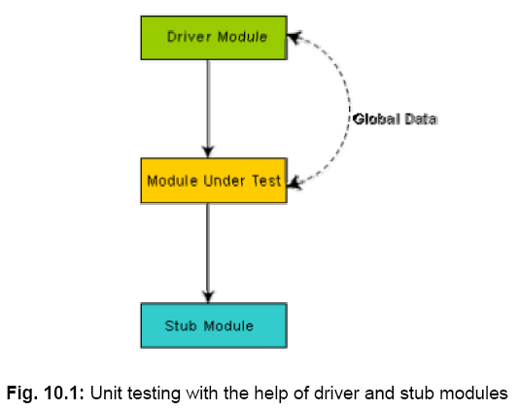
In order to test a single module, a complete environment is needed to provide all that is necessary for execution of the module.

Slide 302
A stub procedure is a dummy procedure that has the same I/O parameters as the given procedure but has a highly simplified behavior.
A driver module contain the nonlocal data structures accessed by the module under test, and would also have the code to call the different functions of the module with appropriate parameter values.

Slide 303
Black box testing
In the black-box testing, test cases are designed from an examination of the input/output values only and no knowledge of design, or code is required.
The following are the two main approaches to designing black box test cases.
Equivalence class portioning
Boundary value analysis

Slide 304
Equivalence Class Partitioning
In this approach, the domain of input values to a program is partitioned into a set of equivalence classes.
The following are some general guidelines for designing the equivalence classes:
If the input data values to a system can be specified by a range of values, then one valid and two invalid equivalence classes should be defined.
If the input data assumes values from a set of discrete members of some domain, then one equivalence class for valid input values and another equivalence class for invalid input values should be defined.

Slide 305
Example#1: For a software that computes the square root of an input integer which can assume values in the range of 0 to 5000, there are three equivalence classes:
The set of negative integers, the set of integers in the range of 0 and 5000, and the integers larger than 5000. Therefore, the test cases must include representatives for each of the three equivalence classes and a possible test set can be: {-5,500,6000}.

Slide 306
Boundary Value Analysis
A type of programming error frequently occurs at the boundaries of different equivalence classes of inputs.
Example: For a function that computes the square root of integer values in the range of 0 and 5000, the test cases must include the following values: {0, -1,5000,5001}.

Slide 307
White box testing
One white-box testing strategy is said to be stronger than another strategy, if all types of errors detected by the first testing strategy is also detected by the second testing strategy
When two testing strategies detect errors that are different at least with respect to some types of errors, then they are called complementary.

Slide 308
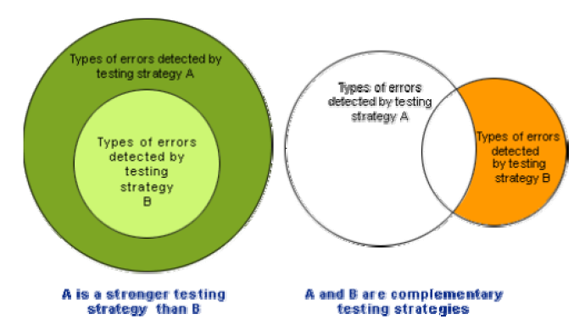

Slide 309
Statement coverage
The statement coverage strategy aims to design test cases so that every statement in a program is executed at least once.

Slide 310
Example: Consider the Euclid’s GCD computation algorithm:
int compute_gcd(x, y)
int x, y;
{
1 while (x! = y){
2 if (x>y) then
3 x= x – y;
4 else y= y – x;
5 }
6 return x;
}
By choosing the test set {(x=3, y=3), (x=4, y=3), (x=3, y=4)}, we can exercise the program such that all statements are executed at least once.

Slide 311
Branch coverage
In the branch coverage-based testing strategy, test cases are designed to make each branch condition to assume true and false values in turn. Branch testing is also known as edge testing as in this testing scheme, each edge of a program’s control flow graph is traversed at least once.
It is obvious that branch testing guarantees statement coverage and thus is a stronger testing strategy compared to the statement coverage-based testing. For Euclid’s GCD computation algorithm , the test cases for branch coverage can be {(x=3, y=3), (x=3, y=2), (x=4, y=3), (x=3, y=4)}.

Slide 312
Condition coverage
In this structural testing, test cases are designed to make each component of a composite conditional expression to assume both true and false values.

Slide 313
Path coverage
The path coverage-based testing strategy requires us to design test cases such that all linearly independent paths in the program are executed at least once. A linearly independent path can be defined in terms of the control flow graph (CFG) of a program.

Slide 314
Control Flow Graph (CFG)
A control flow graph describes the sequence in which the different instructions of a program get executed.

Slide 315
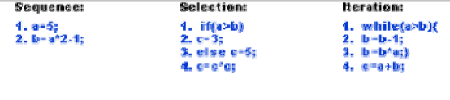
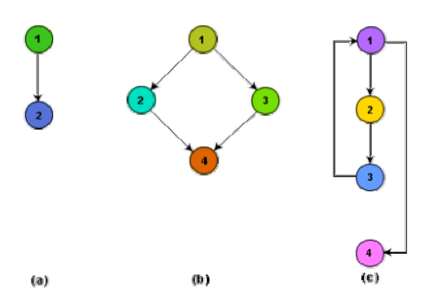

Slide 316
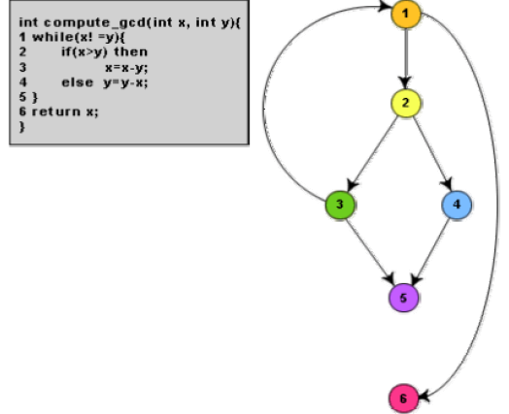
Fig 10.4

Slide 317
Linearly independent path
A linearly independent path is any path through the program that introduces at least one new edge that is not included in any other linearly independent paths. If a path has one new node compared to all other linearly independent paths, then the path is also linearly independent. This is because, any path having a new node automatically implies that it has a new edge. Thus, a path that is subpath of another path is not considered to be a linearly independent path.

Slide 318
Cyclomatic complexity
The McCabe’s cyclomatic complexity metric provides a practical way of determining the maximum number of linearly independent paths in a program.

Slide 319
Method 1:
Given a control flow graph G of a program, the cyclomatic complexity V(G) can be computed as:
V(G) = E – N + 2
where N is the number of nodes of the control flow graph and E is the number of edges in the control flow graph.
For the CFG of example shown in fig. 10.4, E=7 and N=6. Therefore, the cyclomatic complexity = 7-6+2 = 3.

Slide 320
Method 2:
An alternative way of computing the cyclomatic complexity of a program from an inspection of its control flow graph is as follows:
V(G) = Total number of bounded areas + 1
In the program’s control flow graph G, any region enclosed by nodes and edges can be called as a bounded area. This is an easy way to determine the McCabe’s cyclomatic complexity. But, what if the graph G is not planer . Therefore, for non-structured programs, this way of computing the McCabe’s cyclomatic complexity cannot be used.

Slide 321
For the CFG example shown in fig. 10.4, from a visual examination of the CFG the number of bounded areas is 2. Therefore the cyclomatic complexity, computing with this method is also 2+1 = 3.

Slide 322
Method 3:
The cyclomatic complexity of a program can also be easily computed by computing the number of decision statements of the program. If N is the number of decision statement of a program, then the McCabe’s metric is equal to N+1.

Slide 323
Steps to carry out path coverage-based testing
Draw control flow graph.
Determine V(G).
Determine the cyclometic complexity, which gives the minimum number of test cases required to achieve path coverage.
Repeat
Test using a randomly designed set of test cases. Perform dynamic analysis to check the path coverage achieved.
Until at least 90% path coverage is achieved.

Slide 324
Data flow-based testing
Data flow-based testing method selects test paths of a program according to the locations of the definitions and uses of different variables in a program.
Mutation testing
In mutation testing, the software is first tested by using an initial test suite built up from the different white box testing strategies. After the initial testing is complete, mutation testing is taken up. The idea behind mutation testing is to make few arbitrary changes to a program at a time. Each time the program is changed, it is called as a mutated program and the change effected is called as a mutant.

Slide 325
Need for debugging :
Once errors are identified in a program code, it is necessary to first identify the precise program statements responsible for the errors and then to fix them. Identifying errors in a program code and then fix them up are known as debugging.

Slide 326
Debugging approaches
Brute Force Method:
This is the most common method of debugging but is the least efficient method. In this approach, the program is loaded with print statements to print the intermediate values with the hope that some of the printed values will help to identify the statement in error. This approach becomes more systematic with the use of a symbolic debugger (also called a source code debugger), because values of different variables can be easily checked and break points and watch points can be easily set to test the values of variables effortlessly.

Slide 327
Backtracking:
This is also a fairly common approach. In this approach, beginning from the statement at which an error symptom has been observed, the source code is traced backwards until the error is discovered. Unfortunately, as the number of source lines to be traced back increases, the number of potential backward paths increases and may become unmanageably large thus limiting the use of this approach.

Slide 328
Cause Elimination Method:
In this approach, a list of causes which could possibly have contributed to the error symptom is developed and tests are conducted to eliminate each. A related technique of identification of the error from the error symptom is the software fault tree analysis.
Ref: https://www.youtube.com/watch?v=NIJ_iV96j6Q

Slide 329
Program Slicing:
This technique is similar to back tracking. Here the search space is reduced by defining slices. A slice of a program for a particular variable at a particular statement is the set of source lines preceding this statement that can influence the value of that variable [Mund2002].

Slide 330
Integration testing
The primary objective of integration testing is to test the module interfaces, i.e. there are no errors in the parameter passing, when one module invokes another module. During integration testing, different modules of a system are integrated in a planned manner using an integration plan. The integration plan specifies the steps and the order in which modules are combined to realize the full system. After each integration step, the partially integrated system is tested. An important factor that guides the integration plan is the module dependency graph. The structure chart (or module dependency graph) denotes the order in which different modules call each other. By examining the structure chart the integration plan can be developed.

Slide 331
Integration test approaches
• Big bang approach
• Top-down approach
• Bottom-up approach
• Mixed-approach

Slide 332
Big-Bang Integration Testing
It is the simplest integration testing approach, where all the modules making up a system are integrated in a single step. In simple words, all the modules of the system are simply put together and tested. However, this technique is practicable only for very small systems. The main problem with this approach is that once an error is found during the integration testing, it is very difficult to localize the error as the error may potentially belong to any of the modules being integrated. Therefore, debugging errors reported during big bang integration testing are very expensive to fix.

Slide 333
Bottom-Up Integration Testing
In bottom-up testing, each subsystem is tested separately and then the full system is tested. A subsystem might consist of many modules which communicate among each other through well-defined interfaces. The primary purpose of testing each subsystem is to test the interfaces among various modules making up the subsystem. Both control and data interfaces are tested. The test cases must be carefully chosen to exercise the interfaces in all possible manners.

Slide 334
Top-Down Integration Testing
Top-down integration testing starts with the main routine and one or two subordinate routines in the system. After the top-level ‘skeleton’ has been tested, the immediately subroutines of the ‘skeleton’ are combined with it and tested. Top-down integration testing approach requires the use of program stubs to simulate the effect of lower-level routines that are called by the routines under test. A pure top-down integration does not require any driver routines. A disadvantage of the top-down integration testing approach is that in the absence of lower-level routines, many times it may become difficult to exercise the top-level routines in the desired manner since the lower-level routines perform several low-level functions such as I/O.

Slide 335
Mixed Integration Testing
A mixed (also called sandwiched) integration testing follows a combination of top-down and bottom-up testing approaches. In top-down approach, testing can start only after the top-level modules have been coded and unit tested. Similarly, bottom-up testing can start only after the bottom level modules are ready. The mixed approach overcomes this shortcoming of the top-down and bottom-up approaches. In the mixed testing approaches, testing can start as and when modules become available. Therefore, this is one of the most commonly used integration testing approaches.

Slide 336
Phased vs. incremental testing
• In incremental integration testing, only one new module is added to the partial system each time.
• In phased integration, a group of related modules are added to the partial system each time.

Slide 337
System testing :
System tests are designed to validate a fully developed system to assure that it meets its requirements. There are essentially three main kinds of system testing:
• Alpha Testing. Alpha testing refers to the system testing carried out by the test team within the developing organization.
• Beta testing. Beta testing is the system testing performed by a select group of friendly customers.
• Acceptance Testing. Acceptance testing is the system testing performed by the customer to determine whether he should accept the delivery of the system.

Slide 338
Performance testing
• Stress testing
• Volume testing
• Configuration testing
• Compatibility testing
• Regression testing
• Recovery testing
• Maintenance testing
• Documentation testing
• Usability testing

Slide 339
Stress Testing
Stress testing is also known as endurance testing. Stress testing evaluates system performance when it is stressed for short periods of time. Stress tests are black box tests which are designed to impose a range of abnormal and even illegal input conditions so as to stress the capabilities of the software. Input data volume, input data rate, processing time, utilization of memory, etc. are tested beyond the designed capacity. For example, suppose an operating system is supposed to support 15 multiprogrammed jobs, the system is stressed by attempting to run 15 or more jobs simultaneously. A real-time system might be tested to determine the effect of simultaneous arrival of several high-priority interrupts.

Slide 340
Volume Testing
It is especially important to check whether the data structures (arrays, queues, stacks, etc.) have been designed to successfully extraordinary situations. For example, a compiler might be tested to check whether the symbol table overflows when a very large program is compiled.

Slide 341
Usability Testing
Usability testing concerns checking the user interface to see if it meets all user requirements concerning the user interface. During usability testing, the display screens, report formats, and other aspects relating to the user interface requirements are tested.

Slide 342
Documentation Testing
It is checked that the required user manual, maintenance manuals, and technical manuals exist and are consistent. If the requirements specify the types of audience for which a specific manual should be designed, then the manual is checked for compliance.

Slide 343
Maintenance Testing
This testing addresses the diagnostic programs, and other procedures that are required to be developed to help maintenance of the system. It is verified that the artifacts exist and they perform properly.

Slide 344
Recovery Testing
Recovery testing tests the response of the system to the presence of faults, or loss of power, devices, services, data, etc. The system is subjected to the loss of the mentioned resources (as applicable and discussed in the SRS document) and it is checked if the system recovers satisfactorily. For example, the printer can be disconnected to check if the system hangs. Or, the power may be shut down to check the extent of data loss and corruption.

Slide 345
Compatibility Testing
This type of testing is required when the system interfaces with other types of systems. Compatibility aims to check whether the interface functions perform as required. For instance, if the system needs to communicate with a large database system to retrieve information, compatibility testing is required to test the speed and accuracy of data retrieval.

Slide 346
Regression Testing
This type of testing is required when the system being tested is an upgradation of an already existing system to fix some bugs or enhance functionality, performance, etc. Regression testing is the practice of running an old test suite after each change to the system or after each bug fix to ensure that no new bug has been introduced due to the change or the bug fix. However, if only a few statements are changed, then the entire test suite need not be run - only those test cases that test the functions that are likely to be affected by the change need to be run.

Slide 347
Error seeding
Sometimes the customer might specify the maximum number of allowable errors that may be present in the delivered system. These are often expressed in terms of maximum number of allowable errors per line of source code. Error seed can be used to estimate the number of residual errors in a system.

Slide 349
Software Reliability
Software reliability can be defined as the probability, the software will operate failure free for a specified duration under specified operating condition.

Slide 350
Hardware versus Software Reliability
Hardware components fail due to very different reasons as compared to software components.
Hardware components fail mostly due to wear and tear ,whereas software components fail due to bugs.

Slide 351
Hardware Product
Burn In
Wear Out
Failure Rate
Useful Life
Time

Slide 352
Software Product
REtirement
Product Release
Failure Rate
Useful Life
TEsting
Obsolete
Time

Slide 353
Reliability Metric
Rate of Occurrence Of Failure(ROCOF) :
It measures the frequency of occurrence of unexpected
Behavior(failure).This measure obtained by observing the behavior over a specified time interval & then calculating the total number of failures during this interval.

Slide 354
Mean Time to Failure (MTTF) :
This is the average time between two successive failures, observed over a large number of failure.Let the failures occur at the time instants t1,t2…tn
_{n}
The MTTF = ∑i=1 (ti+1 - ti ) /(n-1)

Slide 355
Mean Time to Repair(MTTR) :
MTTR measures the average time it takes to track the errors causing the failure & then to fix them.

Slide 356
Mean Time Between Failures (MTBF) :
We can combine the MTTF & MTTR metric to get the MTBF metric. MTBF of 300 hours means that once a failure occurs ,the next failure is expected to occur only after 300 hours. The time measurements are real time & not the execution time as in MTTF

Slide 357
Probability of Failure on Demand (POFOD) :
POFOD measures the likelihood of the system failing when a service request is made. For example , POFOD of 0.001 would mean that 1 out of every 1000 service requests would result in a failure.

Slide 358
Availability : Availability of a system is a measure of how likely will the system be available for use over given period of time . This metric is important for systems such as telecommunication systems & operating system , which are supposed to be never down & where repair & restart time are significant & loss of service during that time is important.

Slide 359
Classification of Failures :
Transient : this occurs only for certain input values
Permanent : It occurs for all input values while invoking a function of the system.
Recoverable : When it occurs , the system recovers with or without intervention.
Unrecoverable : In unrecoverable failures , the system may need to be restarted.
Cosmetic : An example of a cosmetic failure is the case where the mouse button has to be clicked twice instead of once to invoke a given function through the graphical user interface,

Slide 360
Reliability Growth Modelling
Jelinski & Moranda model :
Littlewood & Varall model :

Slide 361
Software Quality
According to one definition quality is something which is hard to define, impossible to measure and at the same time easy to recognize.
It is defined in terms of its fitness of purpose.
It is interpreted in terms of satisfaction of the requirements laid down in the SRS document.

Slide 362
Quality Factor
Portability : If a software product can be easily made to work in different operating system environments, in different machine , with other software product.
Usability : If different categories of users can easily invoke the function of the product.
Reusability : If different modules of the product can easily be reused to developed new product.
Correctness : If different requirements as specified in the SRS document have been correctly implemented.
Maintainability : If error can be easily corrected ,new function can be easily added to the product ,& functionality can be easily modified

Slide 363
Software Quality Management System :
Managerial structure and individual responsibility :
A quality system is actually the responsibility of the organization as a whole. However, every organization has a separate quality department to perform several quality system activities. The quality system of an organization should have support of the top management. Without support for the quality system at a high level in a company, few members of staff will take the quality system seriously.

Slide 364
Quality System Activity :
Auditing of the project
Review of the quality system :
Development of standards', procedures , and guidelines, etc.
Production of reports for the top management summarizing the effectiveness of the quality system in the organization.

Slide 365
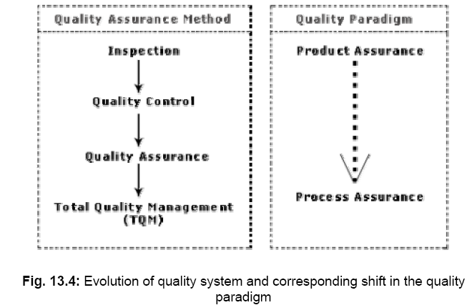

Slide 366
ISO 9000
ISO (International Standards Organization) is a consortium of 63 countries established to formulate and foster standardization. ISO published its 9000 series of standards in 1987. ISO certification serves as a reference for contract between independent parties. The ISO 9000 standard specifies the guidelines for maintaining a quality system

Slide 367
Types of ISO 9000 quality standards
ISO 9001 applies to the organizations engaged in design, development, production, and servicing of goods. This is the standard that is applicable to most software development organizations.
ISO 9002 applies to those organizations which do not design products but are only involved in production. Examples of these category industries include steel and car manufacturing industries that buy the product and plant designs from external sources and are involved in only manufacturing those products. Therefore, ISO 9002 is not applicable to software development organizations.

Slide 368
ISO 9003 applies to organizations that are involved only in installation and testing of the products.

Slide 369
Software products vs. other products
Software is intangible in nature and therefore difficult to control. It is very difficult to control and manage anything that is not seen. In contrast, any other industries such as car manufacturing industries where one can see a product being developed through various stages such as fitting engine, fitting doors, etc. Therefore, it is easy to accurately determine how much work has been completed and to estimate how much more time will it take.

Slide 370
Software products vs. other products
During software development, the only raw material consumed is data. In contrast, large quantities of raw materials are consumed during the development of any other product.

Slide 371
Need for obtaining ISO 9000 certification
Confidence of customers in an organization increases when organization qualifies for ISO certification.
ISO 9000 requires a well-documented software production process to be in place. A well-documented software production process contributes to repeatable and higher quality of the developed software.

Slide 372
Need for obtaining ISO 9000 certification
ISO 9000 makes the development process focused, efficient, and cost-effective.
ISO 9000 certification points out the weak points of an organization and recommends remedial action.
ISO 9000 sets the basic framework for the development of an optimal process and Total Quality Management (TQM).

Slide 373
Summary of ISO 9001 certification
Management Responsibility (4.1)
Quality System (4.2)
Contract Reviews (4.3)
Design Control (4.4)
Document Control (4.5)
Purchasing (4.6)
Purchaser Supplied Product (4.7)
Product Identification (4.8)
Process Control (4.9)

Slide 374
Summary of ISO 9001 certification
Inspection and Testing (4.10)
Inspection, Measuring and Test Equipment (4.11)
Inspection and Test Status (4.12)
Control of Nonconforming Product (4.13)
Corrective Action (4.14)
Handling, (4.15)
Quality records (4.16)
Quality Audits (4.17)
Training (4.18)

Slide 375
Salient features of ISO 9001 certification
All documents concerned with the development of a software product should be properly managed, authorized, and controlled. This requires a configuration management system to be in place.
Proper plans should be prepared and then progress against these plans should be monitored.

Slide 376
Salient features of ISO 9001 certification
Important documents should be independently checked and reviewed for effectiveness and correctness.
The product should be tested against specification.
Several organizational aspects should be addressed e.g., management reporting of the quality team.

Slide 377
Shortcomings of ISO 9000 certification
ISO 9000 requires a software production process to be adhered to but does not guarantee the process to be of high quality. It also does not give any guideline for defining an appropriate process.
ISO 9000 certification process is not fool-proof and no international accreditation agency exists. Therefore it is likely that variations in the norms of awarding certificates can exist among the different accreditation agencies and also among the registrars.

Slide 378
Shortcomings of ISO 9000 certification
ISO 9000 does not automatically lead to continuous process improvement, i.e. does not automatically lead to TQM.
Software development is a creative process and individual skills and experience are important.

Slide 379
CASE tool and its scope
A CASE (Computer Aided Software Engineering) tool is a generic term used to denote any form of automated support for software engineering.
Many CASE tools are available. Some of these CASE tools assist in phase related tasks such as specification, structured analysis, design, coding, testing, etc.; and others to non-phase activities such as project management and configuration management.

Slide 380
Reasons for using CASE tools
The primary reasons for using a CASE tool are:
To increase productivity
To help produce better quality software at lower cost

Slide 381
CASE environment
Although individual CASE tools are useful, the true power of a tool set can be realized only when these set of tools are integrated into a common framework or environment.

Slide 382
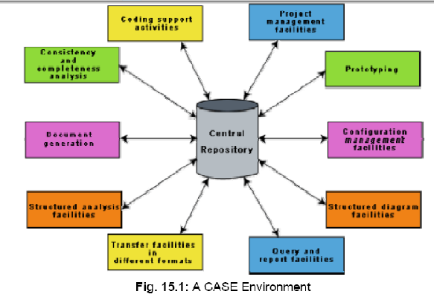

Slide 383
Benefits of CASE
A key benefit arising out of the use of a CASE environment is cost saving through all development phases. Different studies carry out to measure the impact of CASE put the effort reduction between 30% to 40%.
Use of CASE tools leads to considerable improvements to quality.
CASE tools help produce high quality and consistent documents.

Slide 384
CASE tools take out most of the drudgery in a software engineer’s work. For example, they need not check meticulously the balancing of the DFDs but can do it effortlessly through the press of a button.
CASE tools have led to revolutionary cost saving in software maintenance efforts. This arises not only due to the tremendous value of a CASE environment in traceability and consistency checks, but also due to the systematic information capture during the various phases of software development as a result of adhering to a CASE environment.

Slide 385
Introduction of a CASE environment has an impact on the style of working of a company, and makes it oriented towards the structured and orderly approach.

Slide 386
Features of a good prototyping CASE tool
Since one of the main uses of a prototyping CASE tool is graphical user interface (GUI) development, prototyping CASE tool should support the user to create a GUI using a graphics editor. The user should be allowed to define all data entry forms, menus and controls.
It should integrate with the data dictionary of a CASE environment.

Slide 387
Features of a good prototyping CASE tool
If possible, it should be able to integrate with external user defined modules written in C or some popular high level programming languages.
The user should be able to define the sequence of states through which a created prototype can run. The user should also be allowed to control the running of the prototype.
The run time system of prototype should support mock runs of the actual system and management of the input and output data.

Slide 388
Structured analysis and design with CASE tools
A CASE tool should support one or more of the structured analysis and design techniques.
It should support effortlessly drawing analysis and design diagrams.
It should support drawing for fairly complex diagrams, preferably through a hierarchy of levels.

Slide 389
The CASE tool should provide easy navigation through the different levels and through the design and analysis.
The tool must support completeness and consistency checking across the design and analysis and through all levels of analysis hierarchy.

Slide 390
Code generation and CASE tools
The CASE tool should support generation of module skeletons or templates in one or more popular languages.
The tool should generate records, structures, class definition automatically from the contents of the data dictionary in one or more popular languages.

Slide 391
It should generate database tables for relational database management systems .
The tool should generate code for user interface from prototype definition for X window and MS window based applications.

Slide 392
Test case generation CASE tool
It should support both design and requirement testing.
It should generate test set reports in ASCII format which can be directly imported into the test plan document.

Slide 393
Documentation support that might be available from case tool :
The deliverable documents should be organized graphically and should be able to incorporate text and diagrams from the central repository. This helps in producing up-to-date documentation. The CASE tool should integrate with one or more of the commercially available desktop publishing packages. It should be possible to export text, graphics, tables, data dictionary reports to the DTP package in standard forms such as PostScript.

Slide 394
Project management support
The CASE tool should support collecting, storing, and analyzing information on the software project’s progress such as the estimated task duration, scheduled and actual task start, completion date, dates and results of the reviews, etc.

Slide 395
External interface
The CASE tool should allow exchange of information for reusability of design. The information which is to be exported by the CASE tool should be preferably in ASCII format and support open architecture. Similarly, the data dictionary should provide a programming interface to access information. It is required for integration of custom utilities, building new techniques, or populating the data dictionary.

Slide 396
Reverse engineering
The CASE tool should support generation of structure charts and data dictionaries from the existing source codes. It should populate the data dictionary from the source code. If the tool is used for re-engineering information systems, it should contain conversion tool from indexed sequential file structure, hierarchical and network database to relational database systems.

Slide 397
Data dictionary interface
The data dictionary interface should provide view and update access to the entities and relations stored in it. It should have print facility to obtain hard copy of the viewed screens. It should provide analysis reports like cross-referencing, impact analysis, etc. Ideally, it should support a query language to view its contents.

Slide 398
Second-generation CASE tool
Intelligent diagramming support. The fact that diagramming techniques are useful for system analysis and design is well established. The future CASE tools would provide help to aesthetically and automatically lay out the diagrams.

Slide 399
Integration with implementation environment. The CASE tools should provide integration between design and implementation.

Slide 400
Data dictionary standards. The user should be allowed to integrate many development tools into one environment. It is highly unlikely that any one vendor will be able to deliver a total solution. Moreover, a preferred tool would require tuning up for a particular system. Thus the user would act as a system integrator. This is possibly only if some standard on data dictionary emerges.

Slide 401
Customization support. The user should be allowed to define new types of objects and connections. This facility may be used to build some special methodologies. Ideally it should be possible to specify the rules of a methodology to a rule engine for carrying out the necessary consistency checks.

Slide 402
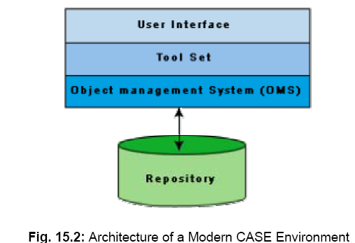
Architecture of a CASE environment

Slide 403
User Interface
The user interface provides a consistent framework for accessing the different tools thus making it easier for the users to interact with the different tools and reducing the overhead of learning how the different tools are used.

Slide 404
Object Management System (OMS) and Repository
Different case tools represent the software product as a set of entities such as specification, design, text data, project plan, etc. The object management system maps these logical entities such into the underlying storage management system (repository). The commercial relational database management systems are geared towards supporting large volumes of information structured as simple relatively short records. There are a few types of entities but large number of instances. By contrast, CASE tools create a large number of entity and relation types with perhaps a few instances of each. Thus the object management system takes care of appropriately mapping into the underlying storage management system.

Slide 405
User Interface Design

Slide 406
Introduction
In any software product,
user interface portion is responsible for all interactions with the user.
Almost every software product has a user interface.

Slide 407
Introduction
Users interact with a software product through its user interface:
user-interface portion of any software is directly relevant to the users.
many users judge a software from its user interface.
User interface design:
a practical and important problem.

Slide 408
Introduction
A difficult user interface:
leads to higher levels of user errors
leads to user dissatisfaction.
Users become particularly irritated when a system behaves in unexpected ways,
issued commands do not carry out actions according to intuitive expectations of users.

Slide 409
Introduction
A significant portion of the total development effort:
spent in developing the user interface.
For many interactive applications:
as much as 50% of the total development effort is spent on the user interface part.

Slide 410
Introduction
If the user interface is not developed systematically:
effort required to develop the interface would increase tremendously,
leading to customer dissatisfaction.

Slide 411
Introduction
It is important to carefully study
user interface design concepts.
Let us examine what a good interface is.

Slide 412
Characteristics of Good User Interfaces
Speed of learning
Speed of use
Speed of recall
Error prevention
Attractiveness
Consistency
Feedback
Support for multiple skill levels
Error recovery
User guidance and online help

Slide 413
Speed of learning:
A good user interface should be simple to learn.
Speed of learning is hampered by complex syntax and semantics of the command issue procedures.

Slide 414
Speed of learning:
A good user interface should not require
users to memorize commands.
An important factor affecting the speed of learning is consistency:
Once, a user learns about a command,
should be able to use similar commands even in different circumstances for carrying out similar actions.

Slide 415
Speed of learning:
Users can learn about an interface faster, if it is based on:
day-to-day real life examples.
use concepts with which users are already familiar.

Slide 416
Speed of use
Speed of use is determined by:
the time and effort necessary to initiate and execute different commands.
The time and user effort necessary to execute different commands should be minimal.

Slide 417
Speed of use
Examples of bad interfaces:
users required to type in lengthy commands
command issue involves moving the mouse to widely different areas of the screen
can slow down the operating speed of users.

Slide 418
Speed of recall
Once users learn how to use an interface:
their speed of recall the commands should be maximized.
The speed of recall is improved if the interface is based on:
metaphors
symbolic command issue procedures
intuitive command names.

Slide 419
Error rate
A good user interface should
minimize the scope of committing errors.
Error rate can be easily measured:
count the errors committed by different users.

Slide 420
How to reduce error possibilities?
Consistency of command names,
Consistency of command issue procedures,
Consistency in behaviour of similar commands
Simplicity of command issue procedure.

Slide 421
Attractiveness
A good user interface should be attractive:
An attractive user interface catches user attention.
In this respect,
graphics-based user interfaces have a definite advantage over text-based interfaces.

Slide 422
Consistency
Consistency of commands is very desirable.
allow users to generalize the knowledge about one aspect of the interface to another.
Consistency helps in:
speed of learning,
speed of recall,
also helps in reduction of error rate.

Slide 423
Feedback
A good user interface must provide constant feedback to user actions:
For example, if any user request takes more than few seconds to process, the user must be informed that his request is still being processed.
If possible, the user should be periodically informed about the progress made in processing the command.

Slide 424
Feedback
In the absence of any response from the computer for a long time:
a novice user might even start recovery/shutdown procedures in panic.

Slide 425
Support for multiple skill levels
A good user interface:
should support different levels of sophistication in command issue procedures:
users with different experience levels prefer different types of interfaces.
Experienced users are more concerned about speed of command issue:
whereas novice users pay prime importance to usability aspects.

Slide 426
Support for multiple skill levels
Novice users discouraged by:
cryptic command names
complex command issue procedures.
Elaborate commands:
slow down command issue procedure
put off experienced users.

Slide 427
Support for multiple skill levels
As users become familiar with an interface:
look for faster command issue procedures such as "hot-keys", "macros", etc.

Slide 428
Error Recovery (Undo facility)
All categories of users commit errors.
A good interface should allow users to undo mistakes.
Users are inconvenienced:
if they can not recover from even simple errors.

Slide 429
User Guidance and On-line Help
Users might need guidance help from the system.
User Guidance is provided through two broad category of methods:
On-line help system
Guidance and error messages produced
in response to user actions.

Slide 430
On-line Help System
User expect the online help message to be related to the context in which they invoke the “help system”.
Therefore, a good online help system should keep track of what a user is doing while invoking the “help system”.

Slide 431
On-line Help System
A good on-line help should:
provide messages in context-dependent way.
help messages should be tailored to user's experience level.
should take advantage of graphics capabilities of the screen.

Slide 432
Guidance Messages
The guidance messages should be carefully designed to prompt the user:
next actions he might take,
current status of the system,
progress made so far in processing the command

Slide 433
Guidance Messages
A good guidance system should have:
different levels of sophistication for different categories of users.
users should have an option to turn off detailed messages.

Slide 434
Error Messages
Error messages should be polite.
Error messages should not be associated with noise.
The messages should suggest how a given error can be rectified.

Slide 435
Error Messages
If appropriate,
the user should be given the option of invoking on-line help to find out more about the error situation.

Slide 436
Mode-based vs. Modeless Interface
A mode is a state or collection of states:
in each state (or mode) different types of commands are available.
Modeless interface:
same set of commands are available at all times.
Mode-based interface:
different sets of commands are available depending on the mode in which the system is.
the mode at any instant is determined by the sequence of commands already issued by the user.

Slide 437
Mode-based vs. Modeless Interface
A mode-based interface can be represented using a state transition diagram:
each node (state) of the state transition diagram represents a mode.
every node of the diagram annotated with command names meaningful in that state.

Slide 438
Graphical User Interface (GUI) vs. Text-based User Interface
In a GUI:
several windows with different information can be simultaneously displayed on user’s screen.
This is perhaps the biggest advantage of GUI.
user can simultaneously interact with several related items at any time.
can even run many unrelated applications.

Slide 439
Graphical User Interface (GUI) vs. Text-based User Interface
Iconic information representation and symbolic information manipulation is possible in a GUI.
Symbolic information manipulation:
such as pulling an icon representing a file into a trash for deleting
It is very easy and user can instantly remember it.

Slide 440
Graphical User Interface (GUI) vs. Text-based User Interface
A GUI can support command selection:
using an attractive and user-friendly menu selection system.
In a GUI, a pointing device can be used:
a mouse or a light pen to issue commands.
The use of a pointing device makes command issue procedure simpler.

Slide 441
Graphical User Interface (GUI) vs. Text-based User Interface
A GUI requires:
special terminals with graphics capabilities
requires special input devices such a mouse.
In contrast, a text-based interface:
can run even on cheap alphanumeric terminals.
Graphics terminals are usually much more expensive than alphanumeric terminals.

Slide 442
Types of User Interfaces
User interfaces can be classified into three categories:
Command language-based interface
Menu-based interface
Direct manipulation interface

Slide 443
Types of User Interfaces
Each category of interface has its advantages and disadvantages:
Modern applications use a combination of all the three types of interfaces.

Slide 444
Choice of Interface
Which parts of the interface should be implemented using what type of interface?
No simple guidelines available
to a large extent it depends on the experience of the designer.
a study of characteristics of the different interfaces would give us some idea.

Slide 445
Command Language-based Interface
As the name itself suggests:
use some language to issue commands.
Users write the required commands in the language:
type them in whenever required.

Slide 446
Command Language-based Interface
Simple command language interface:
determine all the commands needed to be supported
assign unique names to the different commands.

Slide 447
Command Language-based Interface
A more sophisticated command language interface:
allow users to compose complex commands by using a set of primitive commands.

Slide 448
Command Language-based Interface
The facility to compose commands:
reduces the number of command names users would have to remember.
Commands can be made concise
requiring minimal typing by the user.
allow faster interaction with the computer
simplify input of complex commands.

Slide 449
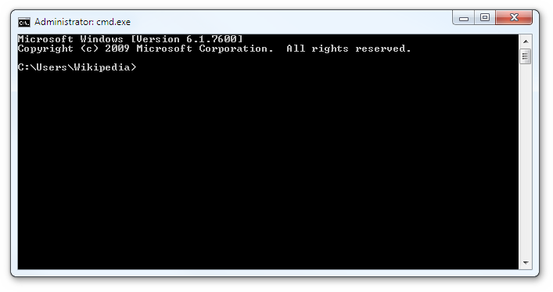

Slide 450
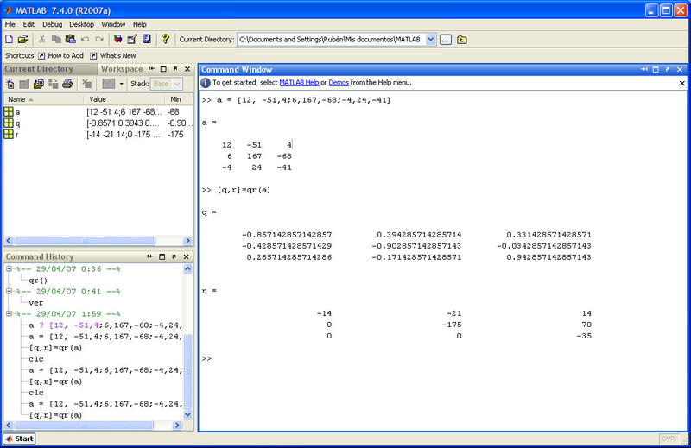

Slide 451
Command Language-based Interface
Advantages:
Easy to develop:
compiler writing techniques are well developed.
Can be implemented even on cheap alphanumeric terminals.
Much more efficient compared to other types of interfaces.

Slide 452
Command Language-based Interface
Disadvantages:
Difficult to learn:
Require the user to memorize primitive commands.
Require the user to type in commands.
Users make errors.

Slide 453
Command Language-based Interface
Disadvantages:
All interactions are through key-board:
cannot take advantage of effective interaction devices such as a mouse.
for casual and inexperienced users, command language interfaces are not suitable.

Slide 454
Command Language-based Interface
Issues:
to reduce the number of primitive commands that a user has to remember.
to minimize the total typing required.

Slide 455
Command Language-based Interface
The designer has to decide what mnemonics to use for the commands, that should be meaningful and short.
The designer has to decide whether users will be allowed to redefine command names to suit their own preferences.

Slide 456
Command Language-based Interface
Letting a user define his own mnemonics for various commands is a useful feature, but it increases complexity of user interface development.

Slide 457
Command Language-based Interface
The ability to combine commands is a powerful facility for experienced users:
but quite unnecessary for inexperienced users.

Slide 458
Menu-based Interface
Advantages of a menu-based interface over a command language interface:
users are not required to remember exact command names.
typing effort is minimal:
menu selections using a pointing device.
This factor becomes very important for the users who can not type fast.

Slide 459
Menu-based Interface
For experienced users:
menu-based interfaces is slower than command language interfaces
experienced users can type fast
also get speed advantage by composing simple commands to express complex commands.

Slide 460
Menu-based Interface
Composition of commands in a menu-based interface is not possible.

Slide 461
Menu-based Interface
If the number of choices is large,
it is difficult to design a menu-based interface.
Even moderate sized software needs hundreds or thousands of menu choices.
A major problem with the menu-based interface:
structuring large number of menu choices into manageable forms.

Slide 462
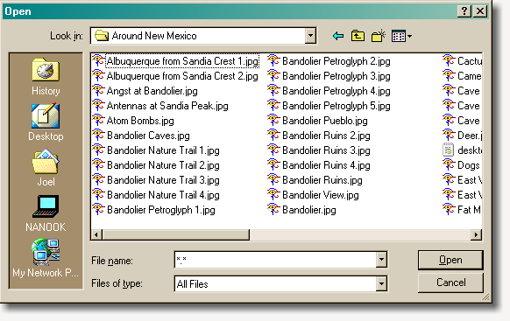

Slide 463
Structuring Menu Interface
Any one of the following options is adopted to structure menu items.
Scrolling menu
Walking menu
Hierarchical menu

Slide 464
Scrolling Menu
Used when the full choice list cannot be displayed within the menu area.
For example: front size selection in a word processing software.
Scrolling of menu items
lets the user to view and select the menu items that can not be accommodated on one screen.

Slide 465
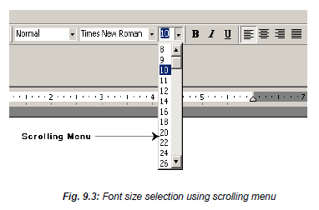

Slide 467
Walking Menu
Walking menu is commonly used to structure a large collection of menu items:
when a menu item is selected,
it causes further menu items to be displayed adjacent to it in a submenu.

Slide 468
Walking Menu
A walking menu can successfully structure commands only if:
there are tens rather than hundreds of choices
each adjacently displayed menu does take up some screen space
the total screen area is after all limited.

Slide 469
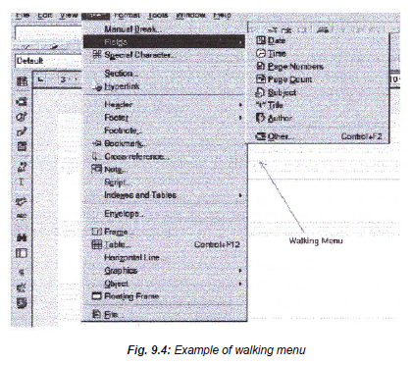

Slide 470
Hierarchical menu
Menu items are organized in a hierarchy or tree structure.
Selecting a menu item causes the current menu display to be replaced by an appropriate submenu.
One can consider the menu and its various submenu to form a hierarchical tree-like structure.

Slide 471
Hierarchical menu
Walking menu is a form of hierarchical menu:
when the tree is shallow.
Hierarchical menu can be used to manage large number of choices.

Slide 472
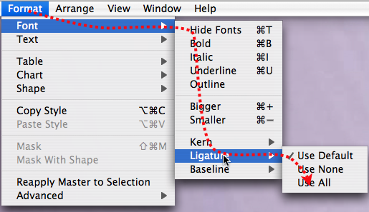

Slide 473
Direct Manipulation Interface
Present the interface to the user in the form of visual models (icons or objects).
Actions are performed on the visual representations of the objects, e.g.
pull an icon representing a file into an icon representing a trash box, for deleting the file.
Direct manipulation interfaces are sometimes called as iconic interfaces.

Slide 474
Direct Manipulation Interface
Important advantages of iconic interfaces:
icons can be recognized by users very easily.
However, experienced users consider direct manipulation interfaces too slow.

Slide 475
Direct Manipulation Interface
It is difficult to form complex commands using a direct manipulation interface.
For example, if one has to drag a file icon into a trash box icon for deleting a file:
to delete all files in a directory one has to perform this operation again and again
very easily done in a command language-interface by issuing a command delete *.*

Slide 476
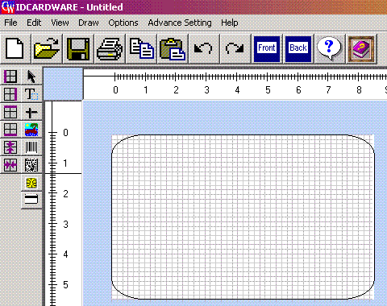

Slide 477
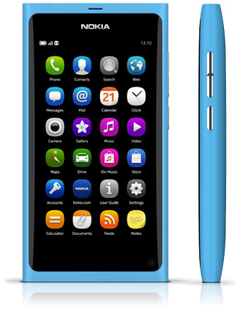

Slide 478
Direct Manipulation Interface
It is difficult to form complex commands using a direct manipulation interface.
For example, if one has to drag a file icon into a trash box icon for deleting a file:
to delete all files in a directory one has to perform this operation again and again
very easily done in a command language-interface by issuing a command delete *.*

Slide 479
Component-Based GUI Development Windowing Systems
Most modern GUIs are developed using some windowing system.
A windowing system can generate displays through a set of windows.
Since a window is a basic entity in such a graphical user interface:
we need to first discuss what exactly a window is.

Slide 480
Window
A window is a rectangular area on the screen.
A window is a is a virtual screen:
it provides an interface to the user for carrying out independent activities,
one window can be used for editing a program and another for drawing pictures, etc.
A window can be divided into two parts:
client part,
non-client part.

Slide 481
Window
The client area makes up the whole of the window,
except for the borders and scroll bars.
The client area is available to the programmer.
Non-client area:
under the control of window manager.

Slide 482
Window management system (WMS)
A graphical interface might consist of a large number of windows,
necessary to have some systematic way to manage the windows.
Window Management System (WMS)

Slide 483
Window management system (WMS)
GUIs are developed using a window management system (WMS):
A window management system is primarily a resource manager.
keeps track of screen area resource
allocates it to the different windows which are using the screen.

Slide 484
Window management system (WMS)
From a broader perspective, a WMS can be considered as a user interface management system (UIMS) ---
not only does resource management,
also provides the basic behavior to windows
provides several utility routines to the application programmer for user interface development.

Slide 485
Window management system (WMS)
A WMS simplifies the task of a GUI designer to a great extent:
provides the basic behavior to the various windows such as move, resize, iconify, etc.
provides routines to manipulate windows such as:
creating, destroying, changing attributes of the windows, and drawing text, lines, etc.

Slide 486

Window management system (WMS)
A WMS consists of two part:
a window manager
a window system.
Window Manager
Application Program
WMS
Window System

Slide 487
Window Manager and Window System
User interacts with window manager to do various window-related operations such as:
window repositioning,
window resizing,
iconification, etc.
Window manager also controls the screen’s real estate policy.

Slide 488
Window manager
The window manager is built on the top of the window system:
makes use of the basic services provided by the window system.
The window manager determines how the windows look and behave.
several kinds of window managers can be based on the same window system.

Slide 489
Window manager
Window manager can be considered as a special program:
makes use of the services (function calls) of the window system.
Application programs
invoke the window system for user interface-related functions.

Slide 490
Window System
Provides a large number of routines for the programmer
It is very cumbersome to use these large set of routines:
most WMS provide a higher-level abstraction called widgets.

Slide 491
Window Management System
A widget is the short form for a window object.
Widgets are the building blocks in interface design.
We know that an object is essentially a collection of:
related data with several operations defined on these data.

Slide 492
Widgets
The data of an window object are:
the geometric attributes (such as size, location etc.)
other attributes such as its background and foreground color, etc.
The operations defined on these data include, resize, move, draw, etc.

Slide 493
Advantages of Widgets
One of the most important reasons to use widgets as building blocks:
provide consistency.
Consistent user interfaces
improve the user's productivity and
lead to higher performance with fewer errors.

Slide 494
Advantages of Widgets
Widgets make users familiar with standard ways of using an interface ---
users can easily extend their knowledge of interface of one application to another
the learning time for users is reduced to a great extent.
Next lecture we will identify standard widgets used to design GUIs.

Slide 495
Software Maintenance
There are basically three types of software maintenance. These are:
Corrective: Corrective maintenance of a software product is necessary to rectify the bugs observed while the system is in use.
Adaptive: A software product might need maintenance when the customers need the product to run on new platforms, on new operating systems, or when they need the product to interface with new hardware or software.
Perfective: A software product needs maintenance to support the new features that users want it to support, to change different functionalities of the system according to customer demands, or to enhance the performance of the system.

Slide 496
Problems associated with software maintenance
Software maintenance work typically is much more expensive than what it should be and takes more time than required.
Maintenance suffers from a poor image, the work involved is often more challenging than development work. During maintenance it is necessary to thoroughly understand someone else’s work and then carry out the required modifications and extensions.
Another problem associated with maintenance work is that the majority of software products needing maintenance are legacy products.

Slide 497
Software reverse engineering
Software reverse engineering is the process of recovering the design and the requirements specification of a product from an analysis of its code.
The first stage of reverse engineering usually focuses on carrying out cosmetic changes to the code to improve its readability, structure, and understandability, without changing of its functionalities.

Slide 498
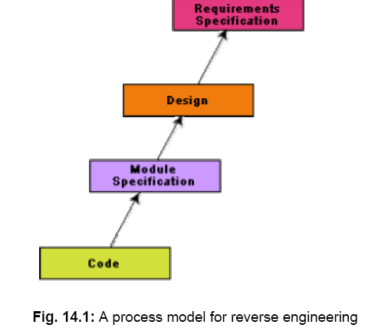

Slide 499
Factors on which software maintenance activities depend
The extent of modification to the product required
The resources available to the maintenance team
The conditions of the existing product (e.g., how structured it is, how well documented it is, etc.)
The expected project risks, etc.

Slide 500
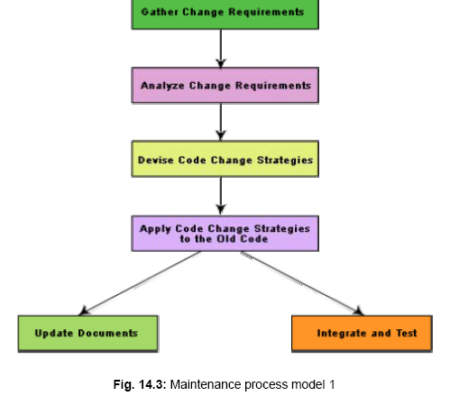
Software maintenance process models

Slide 501
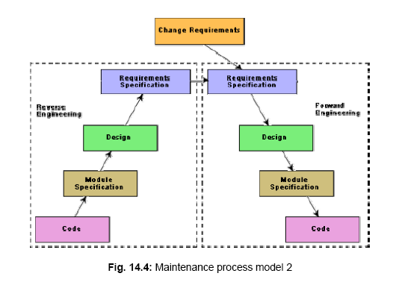

Slide 502
Software Reuse
Advantages of software reuse :
Software products are expensive. Software project managers are worried about the high cost of software development and are desperately look for ways to cut development cost. A possible way to reduce development cost is to reuse parts from previously developed software. In addition to reduced development cost and time, reuse also leads to higher quality of the developed products since the reusable components are ensured to have high quality.

Slide 503
Basic issues in any reuse program
• Component creation
• Component indexing and storing
• Component search
• Component understanding
• Component adaptation
• Repository maintenance

Slide 504
Domain analysis
Reuse domain
Evolution of a reuse domain.

Slide 505
Factors that inhibit an effective reuse program
Need for commitment from the top management.
Adequate documentation to support reuse.
Adequate incentive to reward those who reuse. Both the people contributing new reusable components and those reusing the existing components should be rewarded to start a reuse program and keep it going.
Providing access to and information about reusable components. Organizations are often hesitant to provide an open access to the reuse repository for the fear of the reuse components finding a way to their competitors.

